Slide 1

Changing the Question: A Community Empowerment Workshop Series
Notes:
St. Louis Consultant
Welcome everyone and thank them for their interest in the Community Empowerment Workshop Series. You can share with them that this training is provided by Alive and Well Communities
Alive and Well’s Mission is to Activate Communities to Heal. We do this by:
Elevating community wisdom, centering those who have experienced trauma as leaders of the work.
Disrupting systemic oppression and responding to the impact of historical trauma.
Acting with urgency, not waiting for another day or generation.
Leading innovative solutions based on the science of trauma, toxic stress and resiliency.
Start with introductions and a brief ice-breaker (example: name and special place-if you could go anywhere to relax, where would you go?)
Identify an icebreaker based on group size, age of participants, and set-up of space

Slide 2

Alive and Well Communities activates communities to heal.
We do this by:
Elevating community wisdom, centering those who have experienced trauma as leaders of the work.
Disrupting systemic oppression and responding to the impact of historical trauma.
Acting with urgency, not waiting for another day or generation.
Leading innovative solutions based on the science of trauma, toxic stress and resiliency.

Slide 3
Series 1 – Know Thyself – We’re More than our Experiences Series 2 – Self Care is the Best Care Series 3 – Together we Triumph over Trauma
Changing the Question:
A Community Empowerment Workshop Series
Notes:
Inform participants that this is the first workshop of a three part series. Briefly tell them what the other workshops are.
Remind everyone that the workshop will be discussing trauma and it is important for them to monitor their own reactions to the content and step- out/check-out as needed.

Slide 4
Key Takeaways
An understanding of chronic trauma and toxic stress
An understanding of the impact of chronic trauma and toxic stress on individuals
An understanding of individual’s behavior through a lens of trauma
An Introduction to the Pair of ACEs
Notes:
Announce key takeaways/learning objectives.

Slide 5
part ONE
Building Our Trauma Lens

Slide 6

Shifting our Lens…
What stories do we tell ourselves to explain behavior?
Notes:
Today, we will discuss the science of trauma. We invite you in this conversation to consider how this information causes you to shift your lens to using what we call…the trauma lens.
You don’t have to say it out loud, but think for a minute…think of a friend or family members whose behavior you have tried to understand, but despite trying to understand you still wonder – what’s wrong with them? They may not take good care of themselves. They may rely too much on substances to make it through the day. They may not be able to hold down a job. They may get angry easily. This behavior may have come with some pretty harsh consequences, but they still persist in this behavior.
What you learn today may help explain some of these behaviors. After today’s presentation, we hope you have the tools to begin to shift the question from “What’s wrong with them?” to “What happened to them?” Ultimately, by shifting the question we believe we can identify new solutions that will make our communities healthier and more equitable.

Slide 7
Stress?
Notes:
What is stress?
What are events or situations that are stressful for you?
Ask participants what they think of when they hear the word stress. What does it remind them of or what do they think it means?
Respond by affirming their answers and then letting them know that this presentation is focusing on trauma but it’s important to know that toxic stress has the same impact on our bodies as trauma.

Slide 8
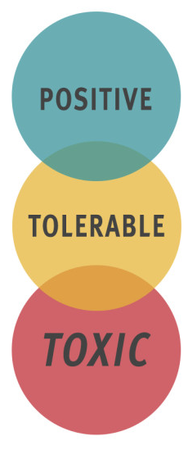
Stress
Brief increase in heart rate
Mild increase in stress hormones
Serious and temporary stress response
Lessoned by supportive relationships
Long activation of stress response
Lack of support systems
Center on the Developing Child – Harvard University
Notes:
Provide examples of stress at each level, then explain how the stress becomes toxic
Positive stress response is a normal and essential part of healthy development, characterized by brief increases in heart rate and mild elevations in hormone levels. Some situations that might trigger a positive stress response are the first day with a new caregiver or receiving an injected immunization.
Tolerable stress response activates the body’s alert systems to a greater degree as a result of more severe, longer-lasting difficulties, such as the loss of a loved one, a natural disaster, or a frightening injury. If the activation is time-limited and buffered by relationships with adults who help the child adapt, the brain and other organs recover from what might otherwise be damaging effects.
Toxic stress response can occur when a child experiences strong, frequent, and/or prolonged adversity—such as physical or emotional abuse, chronic neglect, caregiver substance abuse or mental illness, exposure to violence, and/or the accumulated burdens of family economic hardship—without adequate adult support. This kind of prolonged activation of the stress response systems can disrupt the development of brain architecture and other organ systems, and increase the risk for stress-related disease and cognitive impairment, well into the adult years.
http://developingchild.harvard.edu/science/key-concepts/toxic-stress/

Slide 9
Trauma?
Notes:
Ask participants what they think of when they hear the word trauma. What does it remind them of or what do they think it means?
Respond by affirming their answers and then letting them know that this presentation is going to take a broad approach to understanding trauma.
Some people may hear the examples you just shared and be able to remove themselves from the conversation because they’ve never experienced those traumatic events. However, who in the room has never experienced stress?
Connect stress and trauma→ same effects on the body

Slide 10
Understanding Trauma
Event
Experience
Effects
Threat to someone’s
safety OR lacking resources needed for healthy development
Can be a single event or repeated events.
How someone assigns meaning to the event, which depends on the perception of the individual.
Results of the person’s experience of the event
– SAMHSA, Trauma and Justice
Notes:
Trauma is an event that overwhelms our ability to cope.
As awareness of the impact of trauma grows, it is important to understand that each individual’s perception of what is traumatic may differ depending on their personal level of resiliency and the external support networks they have.
At the national and state levels, dialogues have begun to provide a more personal or individualized definition of trauma that takes into account differences in internal and external supports and strengths.
The “Experience” of the “Event” may be different resulting in different “Effects. The first person may have few and short term effects, while the other without intervention may have more serious effects. Remember ONLY THE PERSON WHO EXPERIENCED THE EVENT CAN SAY WHETHER IT WAS TRAUMATIC AND WHAT WAS TRAUMATIC
Give a clear example:
You may wish to give an example of two individuals who experienced the same event but because one has a calm temperament with extensive family and friends to support them and the other has a more irritable temperament with limited friends and families to support them.

Slide 11

Private Event Trauma
Characterized by:
Secrecy
Power imbalance
Sense of hopelessness
Sense of isolation
Sense of irretrievable loss
Notes:
Private events include any type of abuse: domestic (or IPV), sexual, verbal, emotional, spiritual, financial, technological. These events typically are conducted in secret, with the perpetrator possibly threatening to harm the victim/survivor or others in some way if they say anything. Such threats can include harm to the victim, being removed from the home or harm to a family member, manipulation, coercion, or force. In the case of young children, they may not be aware that what is happening to them isn’t “normal”.
In these situations, there is often a power imbalance between the victim/survivor and the perpetrator. This can be due to age (child and adult), financial dependence or role (teacher, priest, police officer etc). This is important as we will learn that individuals with trauma histories often do not trust people in authority, as they have been harmed previously by such people. Each of us, in our professional capacities, may be viewed as an authority figure. This impacts our engagement efforts.
Those having experienced private events often talk of experiencing a raging sense of hopelessness. Perhaps because of the secrecy and power imbalance, they believe there is no hope that anything will change.
A sense of isolation is reported as well, cut off from others since they can’t talk about it. They may also feel different from others or isolate themselves so no one will discover the truth.
People report having a sense of loss…it may be of their childhood, their innocence or of their safety. Each individual’s sense of loss can be different and it may not be the most horrific thing that happened. For example it could be the loss of their children to the system, or their inability to complete their education. Only the person who experienced the trauma can say what they feel they have lost.

Slide 12

Public Event Trauma
Characterized by:
Shared experience
Lack of judgment
Sense of helplessness
Forces beyond control
Sense of irretrievable loss
Notes:
Public events that can be traumatic include natural disasters, such as a tornado or flooding, car accidents, painful and prolonged medical treatment, war or crime victimization.
These events typically are shared experiences and talked about with others. There is typically no judgment attached initially to being involved with the event.
Individuals experiencing a public traumatic event often report a sense of helplessness. This may come from feeling that they have no ability to avoid or prevent the event. We can’t stop a tornado. And like with those experiencing private traumatic events, a sense of irretrievable loss is also often reported.
As noted before, the same survival response kicks into action in the brain that prepares our body to fight, flight or freeze.

Slide 13

Community Trauma
Characterized by:
A combination of experiences that negatively impact a community
An event that impacts a few people but has structural and social consequences
Notes:
Community Trauma are those events that occur outside of our homes yet, still affect us.
These events may be shared experiences like public event trauma or a private event that can effect a community. They aren’t often described as traumatic but have very similar effects of hopelessness and helplessness both on communities and individuals within the communities. They can be both a symptom of trauma and a cause of additional trauma. i.e. neighborhood violence, poverty, opioid epidemic.
As noted before, the same survival response kicks into action in the brain that prepares our body to fight, flight or freeze.
Participants may want to discuss this in greater detail, however, for the sake of time, inform them that there is a full workshop series dedicated to this topic. If it is scheduled, let them know when they can attend.

Slide 14
Emotional and Physical Reaction
Fight
Flight
Freeze
When our safety feels threatened, our minds
and bodies automatically respond in one of three ways:
Notes:
The fight, flight, and freeze response is activated whenever we are faced with any stressful situation. It triggers the release of certain chemicals and hormones in the body and can effect things like heart rate, blood flow, memory formation, and blood sugar.
This response is controlled by the most basic and primitive part of the brain and decides how to act to best support survival.
You may wish to give an example of what different reactions look like in the face of a threat, i.e. when we encounter a bear (do we fight it, run away, or play dead?) or in a situation like domestic violence.
Focus on the automatic nature of this reaction.

Slide 15
Chronic Trauma
Multiple instances of the same traumatic event
Multiple traumatic events happening to the same person
Environmental or community trauma
or
or
Chronic Trauma affects all areas of functioning from our brains to our bodies.
Notes:
Chronic trauma refers to multiple traumatic events happening to the same person. It can be the same type of event occurring over a period of time (physical abuse, sexual abuse, domestic violence, unable to pay bills, poverty, etc.) or it can be different types of events that occur to the same person over a period of time. For example, a child who was physically abused as an infant; had an intrusive, painful medical procedure at the age of 5; was in a car accident in which a sibling was killed at the age of 8; and was raped in the community at the age of 10.
The impact of these events is cumulative and should not be viewed as separate discrete events. Each subsequent event brings forward memories and reactions from the previous event.
Chronic trauma is also connected to toxic stress, or the kind of stress that negatively impacts the body because of continuous activation of the stress response. Examples include things like living in poverty, chronic hunger, living in violent neighborhoods, etc.
Chronic trauma is typically when we see the most devastating impact on an individual’s functioning in all areas and what we typically will be referring to throughout this presentation.
However, about a third of children that experience one traumatic event will still experience significant impact on their functioning if they don’t receive targeted interventions and support for trauma.
STOP HERE FOR GROUP DISCUSSION
Discussion Questions
What are some examples of community trauma? Why do you consider that traumatic?
What are some examples of environmental trauma? do you consider that traumatic?

Slide 16
Adverse Childhood Experience (ACE) Study
Without intervention…
Adverse Childhood
Experiences
Impact of Trauma & Health Risk Behaviors
Long-Term Consequences
of Trauma
Child abuse
Trauma in child’s home
Child neglect
Mental effects of trauma
Ex: depression, anxiety
Health risk behaviors
Ex: smoking, alcoholism
Disease
Ex: cancer, heart disease
Social Problems
Ex: homelessness, inability to parent
Adapted from presentation Jennings (2006). The Story of a Child’s Path to Mental Illness.
Notes:
The Adverse Childhood Experience (ACE) Study is the seminal research that identified the impact that childhood trauma could have on long-term functioning and outcomes.
It was started in 1995 by Kaiser Permanente, a large health insurance company. It started as a review of a weight loss program in which they found individuals were dropping out of treatment as they began to lose weight.
In subsequent interviews the common factor that was discovered was a history of childhood sexual abuse. Participants reported they began overeating and putting on weight in response to the abuse as a mechanism with the belief that if overweight they would be less attractive and therefore at less risk for sexual abuse. As adults, years later, as they began to lose weight their anxieties and fears returned, prompting them to drop out of the program. In partnership with the CDC a large study was conducted that had over 17,000 participants in which their medical and social histories were examined. It was here that the relationship between childhood abuse and negative household functioning was found to be related to long-term health and social outcomes.
The slide shows this relationship. On the far left are 10 events that an individual may have experienced. Note to participants that this is not an exhaustive list but the 10 adverse childhood experiences included in this study. Quickly review the list. The middle column shows the symptoms and behaviors that develop which then leads to the social and health outcomes years later. The ultimate health outcome is that individuals with trauma histories have a lifespan that on average is shorter by 20-25 years compared to those without such a history.
These findings result in trauma being viewed as a major public health issue.
There is a possibility of having chronic health diseases without health risk behaviors

Slide 17
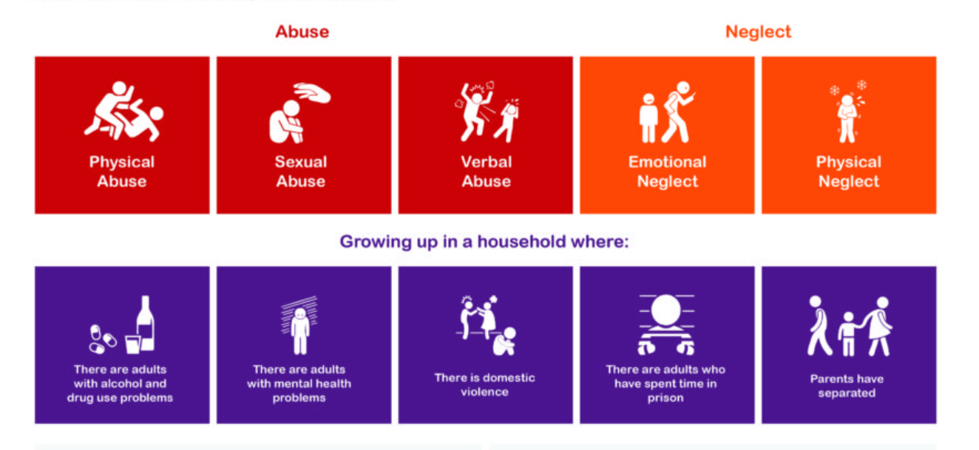
Adverse Childhood Experience (ACE) Study
Image: www.liverpoolcamhs.com
Notes:
This slide highlights the 10 ACEs Dr. Vince Felitti looked at as he conducted the ACE Study

Slide 18
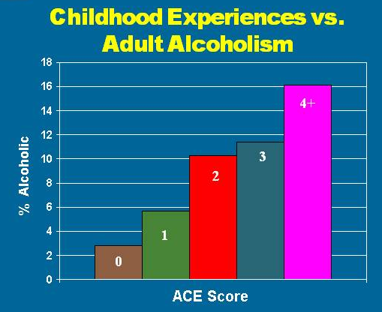

Health Risk Behaviors
Adult Alcoholism
% Alcoholic
Ace Score
Notes:
This graph demonstrates the relationship between adverse childhood experiences and rates of alcoholism in adults.
Explain that alcohol, just like other substances, can be used as a coping mechanism. Used over time, this can lead to substance use disorders (abuse and dependency) and negative impacts on one’s life and functioning.
Here we see that more than a 500% increase in adult alcoholism is related in a strong, graded manner to adverse childhood experiences.
Beyond alcoholism:
When we studied the relation of injecting illicit drugs to adverse childhood experiences, we again found a similar dose-response pattern; the likelihood of injection of street drugs increases strongly and in a graded fashion as the ACE Score increases.
At the extremes of ACE Score, the figures for injected drug use are even more powerful. For instance, a male child with an ACE Score of 6, when compared to a male child with an ACE Score of 0, has a 46-fold (4,600%) increase in the likelihood of becoming an injection drug user sometime later in life
THIS SLIDE CAN BE USED FOR TABLE OR GROUP DISCUSSIONS
Discussion Questions
Use these discussion questions after a clear explanation of the ACE study and how the ACE is calculated
What is this chart telling us?
Why do you think this is the case?
Why do you think there is a connection between the number of ACES and alcoholism?
The point of these discussion questions is to get participants to understand how trauma impacts behavior and for them to begin asking what happened to an individual rather than looking directly at the behavior. They should understand “what’s behind the bottle”.

Slide 19
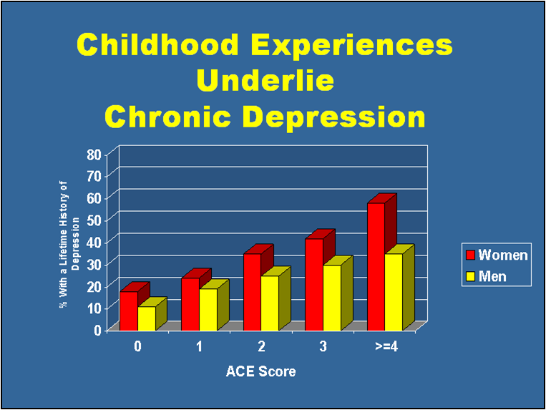
Mental Health Effects
Chronic Depression
% with Chronic Depression
Ace Score
Notes:
Here is one example that shows the relationship between exposure to adverse childhood experiences and likelihood of having chronic depression. For women with no such experiences, less than 20% ever received a diagnosis of depression. While of those with more than four such experiences almost 60% received such a diagnosis.
Notice that women have a higher rate of depression across the board than men. This may be due to two reasons. One is that women internalize more than men so may be at higher risk for developing depression in response to adverse experiences. However it may also be a “self-report” issue as men are less likely to express feelings and/or receive treatment/support for depression.
ACE Study found that adults with an ACE score of 4 or more were 460% more likely to be suffering from depression.
THIS SLIDE CAN BE USED FOR TABLE OR GROUP DISCUSSIONS
Discussion Questions
Use these discussion questions after a clear explanation of the ACE study and how the ACE is calculated
What is this chart telling us?
Why do you think this is the case?
What does this chart tell us about men and women?
Why do you think this is the case?
How would this chart look differently if we replaced Chronic Depression with incarceration rates or oppositional defiant disorder - A disorder marked by defiant and disobedient behavior to authority figures.?

Slide 20
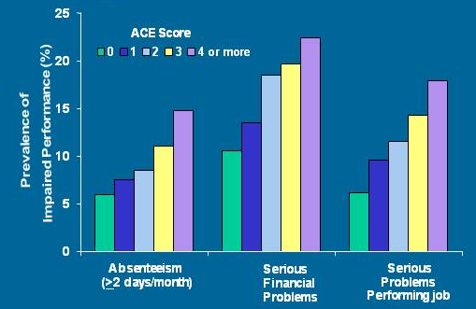
Social Problems
Poor Job Performance
Rate of Poor Performance
Financial Problems
Job Performance Problems
Absenteeism
Notes:
Absenteeism (more than or equal to 2 days/month), serious financial problems, serious problems performing job
Here is another example, but this shows how adverse childhood experiences can impact our employment capacities. As the number of adverse experiences goes up, so does the risk of having higher rates of absenteeism, serious financial problems or serious job problems (frequent disciplinary actions, difficulty maintaining a job etc.)
Keep in mind – this data is from employed and insured people. They have work. But they are experiencing considerable difficulty within the work environment and issues with authority (sometimes caused by private event trauma) can lead to difficult relationships with bosses/supervisors.
Domestic violence victims lose nearly 8 million days of paid work per year in the US alone—the equivalent of 32,000 full-time jobs. The costs of intimate partner violence in the US alone exceed $5.8 billion per year: $4.1 billion are for direct medical and health care services, while productivity losses account for nearly $1.8 billion.
The ACE study shows a higher prevalence of chronic disease for people with higher ACE scores-people with more health problems are more likely to miss work because they are sick.
Missing work or having difficulties with a boss is going to make it difficult to get promotions, maintain employment, etc., leading to financial problems.
THIS SLIDE CAN BE USED FOR TABLE OR GROUP DISCUSSIONS
Discussion Questions
Use these discussion questions after a clear explanation of the ACE study and how the ACE is calculated

Slide 21

Trauma’s Impact on the Body
Chronic trauma or toxic stress causes damage to the body.
Constant use of the stress response system (long-term release of chemicals and hormones, increased blood sugar, faster heart rate, etc.) can lead to poor health outcomes.
Notes:
As part of our body’s response to stress, trauma and perception of danger, chemicals are released. We are all familiar with the impact adrenaline has. A little can help us get through a situation…speaking in public, running a race etc. But too much for too long does not feel good and can literally wear out our body.
Another chemical, glucocorticoids, are released when there is a sudden emotional response…good or bad..that creates what is called flashbulb memories. These are vivid snapshots of the event. This may play a role in the development of flashbacks and/or triggers.
When our body is under constant threat with little recovery time, our stress response reactions do not return to normal, and may get “stuck”.
Some other effects of increased adrenaline and other endocrine hormones in combination include:
Increased cortisol production. Cortisol is a steroid that counters pain and inflammation and keeps blood-sugar at a certain level.
Increased blood sugar. This blood sugar is used to feed the brain and muscles.
Increased heart rate. Blood is pumped more quickly around the body.
Changes in blood-flow. Arterial blood pressure increases. Blood is diverted away from hands, feet and stomach, and towards your brain and major muscle groups. This helps the brain assess the threat and prepares the muscles for action.
Increased platelet levels. More platelets in the bloodstream helps blood clot better and faster if physically injured.
Increased endorphin levels. Endorphins help to dull pain which may allow the body to ignore the pain long enough to engage in survival behaviors.

Slide 22
ACE Study Takeaways
Traumatic experiences are more common than previously thought.
The effects of trauma continue beyond the event itself.
Without intervention, events that happen in childhood can impact us in adulthood.
Notes:
The ACE Study tells us that, without proper intervention, Traumatic events during childhood, can lead to chronic diseases, such as diabetes, heart disease and some types of cancer, as well as depression, alcoholism and drug abuse without intervention.
It’s also important for the audience to understand that because of when the ACE study was conducted (1995) and because of the demographics (predominately White), the study doesn’t cover examples of trauma that we may include today such as social media, racism, historical trauma, poverty, etc. It
The ACE Study also dispels myths.
Address Myths:
Kids are so young, they won’t remember
Kids are so resilient, they will overcome

Slide 23
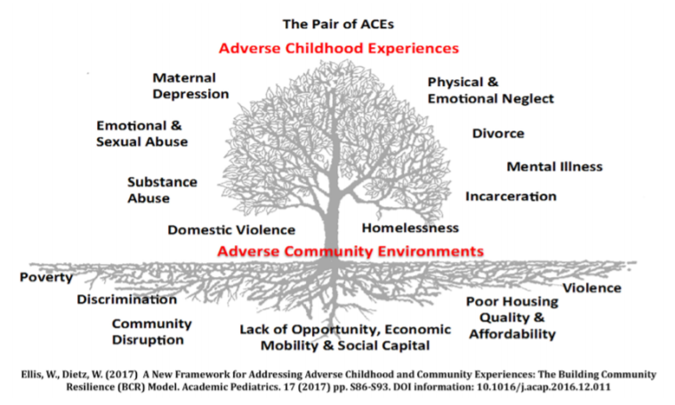
Notes:
The leaves on the tree represent the ‘symptoms’ of ACEs that are easily recognized in clinical, educational and social service settings, such as a well child visit or a pre-school classroom. Adverse childhood experiences can increase a person’s risk for chronic stress and adverse coping mechanisms, and result in lifelong chronic illness such as depression, heart disease, obesity and substance abuse. Physical or sexual violence, and abuse or neglect are often less obvious but can exist as chronic stressors.
The tree is planted in poor soil that is steeped in systemic inequities, robbing it of nutrients necessary to support a thriving community. Adverse community environments such as a lack of affordable and safe housing, community violence, systemic discrimination, and limited access to social and economic mobility compound one another, creating a negative cycle of ever worsening soil that results in withering leaves on the tree.

Slide 24
Layers of Trauma
Poverty
Racism
Individual
Trauma
Community
Trauma
Gender Inequity
Lack of Access
Historical
Trauma
Systemic
Oppression
Xeno-phobia
Violence
Notes:
There is limited recognition of the various types of trauma that may impact an individual. Often, only interpersonal trauma is recognized as having an impact. While interpersonal trauma is often viewed as more correlated and tangible, lying underneath are all of the Adverse Community Environments – the community trauma. Community trauma has roots is historical mechanisms: racism, historical oppression of certain ethnic groups/religious groups, and transgenerational poverty. Note: While there is a national narrative of historical trauma, each individual community has its own unique presence of historical trauma that layers on top of the national narrative. Historical trauma is the result of systemic oppression, and systemic oppression continues to fuel historical trauma today.

Slide 25

How common is trauma?
More than 50% of the general population have experienced at least one traumatic event.
How common is trauma in your community?
Notes:
The 50% prevalence rate came from the Adverse Childhood Experiences Study. More recent surveys have seen the prevalence for 1 or more traumatic events go as high as two-thirds of the adult population. Twenty-five percent of the adult general population has experienced two or more traumas; one of 16 adults has four or more traumatic events and one out of 22 has 6 or more events. This is considered CHRONIC trauma.
Many systems such as child welfare, domestic violence and mental health have extremely high rates, between 80-100%.
Ask participants what they think the prevalence rate is in the community they serve, work in, or live in. Often, they will indicate a much higher prevalence. Affirm that as we broaden our definition of trauma and toxic stress, we see even higher rates than mentioned on the slide.

Slide 26
What’s going on in the country?
As adults, children who were placed in foster care have PTSD rates TWICE as high as US War Veterans.¹
1 in 4 children in the United States will witness or experience a traumatic event before they turn four. ²
1- Northwest Foster Care Alumni Study, 2005
2 - National Center for Mental Health Promotion and Youth Violence Prevention, 2012
Notes:
PTSD was a diagnosis that was developed in response to the needs of veterans from the Vietnam War, yet adults who were in foster care have a higher rate of this diagnosis.
What does this tell us about some systems? We know that to go in state custody children theoretically have been exposed to abuse and/or neglect, but like many systems designed to help, it may actually unintentionally do further harm. In this case, that harm may come from moving a child from place to place, disrupting relationships and perpetuating not feeling safe and being disempowered.
This difficulty in getting true prevalence rates due to several factors, including the inherent nature of some of the types of traumatic events that children experience, the assets available to the field for detecting and counting events, and confounding methodological issues between studies.
Additional talking points:
1 in 2 marriages end in divorce - American Academy of Child and Adolescent Psychiatry, 2013
These statistics tell us that trauma is more prevalent than we think

Slide 27
What’s going on in Kansas?
In High school…
1 in 5 reported being bullied electronically
1 in 5 reported experiencing bullying on school property
1 in 20 reported experiencing physical dating violence
1 in 4 reported feeling sad or hopeless for 2 or more weeks in a row
CDC Youth Online Youth Risk Behavior Surveys for High School, 2017
Notes:
Setting the stage that regardless of wanting to protect our children, they experience trauma
During this difficult period, parents may be preoccupied with their own problems, but continue to be the most important people in their children's lives. While parents may be devastated or relieved by the divorce, children are invariably frightened and confused by the threat to their security. Some parents feel so hurt or overwhelmed by the divorce that they may turn to the child for comfort or direction. This can add to the pressure and stress a child is experiencing. Divorce can be misinterpreted by children unless parents tell them what is happening, how they are involved and not involved, and what will happen to them. Children often believe they have caused the conflict between their parents. Many children assume the responsibility for bringing their parents back together, causing them additional stress. Additionally, the material and relational needs of children tend to not be as fully addressed when parental divorce or separation occurs. - Source: American Academy of Child and Adolescent Psychiatry
Missouri specific data comes from the CDC’s Youth Online, with data collected by Youth Risk Behavior surveys for High School students.

Slide 28
Part TWO
The Science – Trauma’s Impact on the Brain & Applying the Lens

Slide 29

Healthy Brain Development
At birth, the brain is about a quarter the size of the adult brain in weight and volume, but contains nearly the same number of brain cells or neurons (100 billion).
The lower brain is well developed at birth, but the higher regions are less developed.
Higher Brain
Lower Brain
Notes:
So how does this happen…how do these childhood experiences result in these types of negative outcomes? Research now shows us how these childhood traumas impact our brain functioning. To understand we first need to understand a little about how the brain develops.
You may wish to tell participants that it is not crucial to understand all the science behind brain development and the impact of trauma, but it is important to understand that these responses are “wired” into the brain, so we cannot expect an individual to just stop the negative response.
At birth the brain is about 25% of the adult brain in weight and volume. However, the newborn brain has about the same number of neurons or brain cells as that of an adult. Brain development is not about growing brain cells but about growing connections between brain cells. The brain is wired to learn.

Slide 30
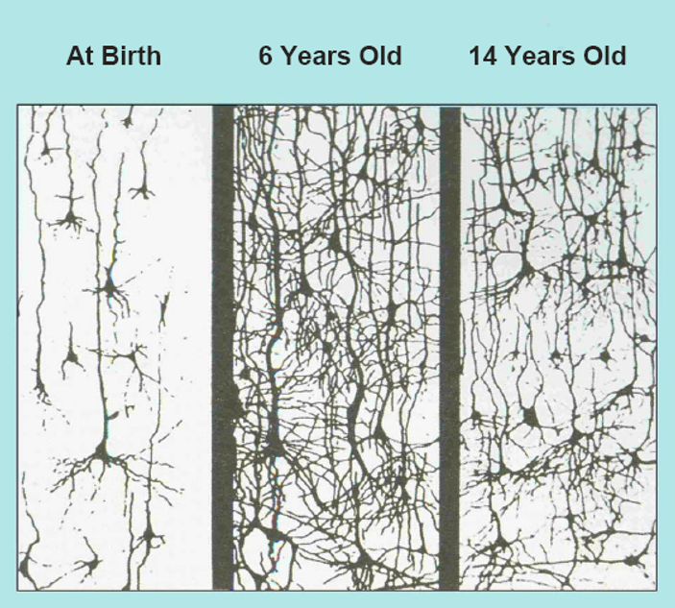
Healthy Brain Development
Connections in the brain form as a child experiences the world.
The used connections are strengthened and the unused connections begin to prune in adolescence.
Notes:
Growing connections happens through stimulation or experience. The first five years are the most critical period for brain development. During this time we want to provide the infant with positive stimulation and an accessible, attuned and responsive adult. Cells/neurons. With repeated exposure, those connections get stronger and stronger. In the field of neurodevelopment it is said that “neurons that fire together, wire together”. We provide experiences such as exposure to language, rattles and other toys to develop eye-hand coordination. With each new experience, new connections are made between the involved brain cells/neurons. With repeated exposure those connections get stronger and stronger.
Adolescence is the 2nd most critical period of development. In adolescence the brain begins to prune neural connections that are weaker because they are not used frequently. This is a natural, healthy process, just like the idea to keep a tree healthy, we prune some of the branches. This pruning process makes the existing neural connections stronger.
Participants often ask whether these unused synapses can return. The answer is basically yes, particularly those in the higher portions of the brain. As we grow older this may take more targeted, intensive and longer interventions, but the brain has plasticity which allows for this continued growth and recovery. It is never too late to have an impact.

Slide 31

Trauma’s Impact on the Brain
Trauma can…
Strengthen survival connections
Reduce the number of connections formed
Reduce the size of the higher brain region
Resulting in…
Short-term memory problems
Attention difficulty
Language development delays
Emotional and behavioral problems
Notes:
So as we noted, experiences and stimulation lead to increasing development of neural connections. It doesn’t matter whether the stimulation is from positive or negative events-the same process occurs.
Repeated experiences lead to stronger and faster connections, which results in more automatic responses. Think of how we practice skills we want to improve, whether swinging a baseball bat or playing a musical instrument. We practice, practice, practice to get better and it becomes almost an automatic response. We don’t have to stop and think about what to do, it just happens.
So think about if a young child is exposed to repeated trauma. That child’s response to the traumatic events becomes “wired into the brain” and with repeated exposure becomes a strong, immediate response. Think back to the survival brain and the three responses programmed into our brain… fight, flight or freeze. When an individual is feeling unsafe or there is a trigger or reminder of past trauma, this part of the brain takes over from the more rational part of the brain.
Some of the impact this can have on a young child’s brain affects the child’s memory, attentional, perceptual, cognitive, and language abilities, as well as the ability to regulate one’s emotions.

Slide 32


Trauma’s Impact on Memories
A traumatic event can create a flashbulb memory.
Triggers cause people to recall these intense, flashbulb memories.
Notes:
It’s important to emphasize that cortisol does not only impact memories of negative traumatic events, but can also create vivid memories of extremely positive moments in life.
Important to distinguish these types of memories from other types of memory-memories formed during times the stress response system is activated often evoke feelings throughout the entire body.
These memories can be associated with “triggers.” Triggers cause people to recall previous traumatic experiences and create physical reactions and interruptions in emotional and behavioral regulation.

Slide 33
Trauma’s Impact on the Nervous System
Activating
Event
Stuck on “High”
Normal Range
Stuck on “Low”
Notes:
After a traumatic event, or cumulative traumatic events over time, or when memories or dynamics of past trauma are triggered again and again - too much activation can overwhelm this reciprocal system of the Autonomic Nervous System. The system can get tragically stuck and homeostasis and the natural internal rhythm may be lost. The person can get stuck on high in Sympathetic hyperarousal that can result in chronic symptoms of anxiety, panic, rage, and/or hyperactivity. Conversely, the person’s nervous system can get stuck on low and fall into the depths of Parasympathetic depressions, disconnection, exhaustion and numbness. Both systems can get stuck at the same time as with one foot on the accelerator of a car and the other on the brake. This results in what is called the freeze response and feelings of chronic helplessness, fatigue, poor concentration and a sense of internal collapse may result. It’s that deer in the headlight look. And as the body’s usual defensive strategies of fight or flight have been thwarted, the survival energy can become locked in the body, trapped in the nervous system. This model is very helpful in helping individuals understand that the symptoms they are experiencing are normal responses of their “nervous system” to abnormal events or to present day triggers to past overwhelming events. This is a natural physiological process. This often makes people feel very relieved because the symptoms can often make people feel like they are going “crazy” IN SUM: we know what the causal pathway is.
This slide shows the pattern of arousal under stress for individuals experiencing chronic trauma. With little time for recovery in between events, the individual goes up and down and then gets stuck either on hyper-arousal or hypo-arousal.
With the former, the individual stays at a higher level of arousal. Research suggests for example that individuals with chronic trauma often have higher resting heart rates than those without a trauma history. When hyper-aroused, individuals may display hyperactivity, hypervigilance (scanning the environment for risk or danger), mania, anxiety or panic and rage. You can ask what diagnoses this may look like and how treatment without recognition of trauma could affect the person’s recovery.
When stuck on hypo-arousal the person may experience depression, dissociative episodes, fatigue and/or numbness. Again you can discuss with participants how this may impact a person’s ability to comply with service plans, meet the child’s needs, manage day to day functioning.

Slide 34
Trauma and Development
How trauma is experienced is dependent on developmental and life stages.
Change can often result in the re-emergence of symptoms.
Early Childhood → Adolescence → Adulthood
Notes:
To understand the impact of trauma, we need to know the development stage(s) the person was in when experiencing the trauma AND their current stage of development and how the trauma history may impact them now. For example, a child who was sexually abused when a young child, may receive appropriate treatment at that time, but as they move into puberty, new triggers may require additional treatment to manage the current developmental requirements.
It’s also important to emphasize that the effects of trauma are not limited to only specific stages of development and may continue throughout development until intervened upon. For example, if a child experiences memory problems and difficulties in paying attention, they may continue to experience that into adulthood.

Slide 35
Trauma’s Impact on Young Children
Delayed verbal skills
Memory problems
Developmental regression
Aggression
Excessive crying or screaming
Problems with focus/learning
Issues with eating and digestion
Bad temper, sadness, anxiety
Nightmares/sleep difficulties
Need to act out the traumatic event
Exaggerated startle response
Difficulty trusting others
Lack of self confidence
Physical complaints
Bed wetting
Notes:
As noted, the first five years are the most critical period for brain development. The brain is very influenced by experience, good or bad at this age.
The other major issue is that young children may not have fully developed language to capture their response to the event. This may make it difficult to frame the trauma event or discuss with others then or later. We should not ever think though that just because they don’t have the language to talk about the impact, that it has not impacted them.
Much of the impact for young children may be in not achieving developmental milestones such as in language. Or it might be possible that they regress in their development. For example, a child who is toilet trained may regress to wetting or soiling. This slide lists a number of other areas that may be impacted in young children.
You can use this slide to give an example of how these effects may play out in a classroom, for example a teacher who places a hand on the shoulder of a student to get their attention and the student has a physical reaction and hits the teacher. If only punishment is given without learning about underlying trauma, you will not be able to ultimately help the child learn
This slide shows a number of other examples of the impact trauma may have on young children. Naptime or bedtime may be a particular time when a child struggles with emotional or behavioral control. This may be related to timing of past traumatic events and the experience of giving up control when others are around when falling asleep.
Young children often act out some components of the traumatic event in their play or in interactions with others. This may reflect feelings of being unsafe or abusive interactions. It is important to remember not to take any actions towards you personally, but to know that this is just their way of expressing what is going on in their world.
Young children into school age often report somatic complaints such as having stomachaches or headaches when there is no physical cause identified.
THIS SLIDE CAN BE USED FOR TABLE OR GROUP DISCUSSIONS
Discussion Questions
Use these discussion questions after a clear explanation of how trauma can impact development as a result of its impact on the brain. Remind participants of “what fires together, wires together” – when a person is constantly using his/her survival brain, that is what is building and growing strong, while other areas are weakening
Do any of these impacts jump out at you?
Have you seen them before in a young child?
Why do you think that these are the potential effects of trauma?

Slide 36
Trauma’s Impact on Adolescents
Fear about safety
Sudden changes in behavior
Difficulty trusting others
Emotional numbing
Repeated thoughts and comments about death or dying (violent or suicidal thoughts, writing, art, or internet searches)
Increased difficulty with authority
Sleep difficulties
Exaggerated startle response
Avoidance behaviors
Re-experiencing the trauma through nightmares or memories
Notes:
This slide lists the impact trauma may have for adolescents. Obviously any change in behavior or in relationships can be a sign of some emotional concerns. We may also see stories or pictures that are violent or morbid in nature. This may cause concern in the adults, but it should again be examined through the lens of trauma in that they may be representing what is happening in their life and may not represent a plan to harm others.
We need to remember that adolescence is the 2nd most critical period of brain development and that the adolescent “Brain” has some unique characteristics even within “typical” development. Such things as requiring a higher level of stimulation to feel normal, or interpreting anger or negative emotions to others facial expressions than children or adults.
This slide lists some additional impacts of trauma. Emotional numbing can lead to engaging in self-injurious behaviors as a way to “feel”.
THIS SLIDE CAN BE USED FOR TABLE OR GROUP DISCUSSIONS
Discussion Questions
Use these discussion questions after a clear explanation of how trauma can impact development as a result of its impact on the brain. Remind participants of “what fires together, wires together” – when a person is constantly using his/her survival brain, that is what is building and growing strong, while other areas are weakening
Do any of these impacts jump out at you?
Have you seen them before in an adolescent?
Why do you think that these are the potential effects of trauma?

Slide 37
Trauma’s Impact on Adults
Depression
Lack of trust, especially in authority
Poor relationships
On-guard
Sluggish or numb
Substance use/self-medicating
Mental illness (ex: PTSD, depression, anxiety…)
Mood swings
Adults may not only experience new traumatic events, but also experience combined effects from childhood trauma.
Notes:
When working with children/adolescents we also need to think about their parents or caregivers. The way an adolescent adapts to stressors has a lot to do with how well his or her family is functioning (Stern & Zevon, 1990). It has been found that when adolescents lack parental support, they are more likely to have behavioral problems and emotional distress (Garber & Little, 2001).
A system of care study looked at the prevalence of trauma within caregivers of children who have experienced trauma. The prevalence rate was high AND the number of traumas experienced was on average 7 events which means this is chronic trauma.
We must think about this when we are attempting to engage a parent/caregiver around the needs of the child. The parent may not have much trust of authority and be mistrustful of any support offered.
This slide provides some examples of how a trauma history may impact parents/caregivers. As professionals, in our roles with children and families, we need to change our perspective when a parent is not meeting objectives or goals from being non-compliant or resistant to being impacting by trauma, and help that parent manage their own emotional and behavioral responses through that lens of trauma.
Mental illness:
Throughout this presentation we have discussed different symptoms or the impact of trauma. Many of these may seem very similar to symptoms of psychiatric disorders such as ADHD or Bipolar Disorder. We are still learning about the relationship between mental disorders and trauma. We certainly know they can co-occur and that having a mental illness can place you at higher risk for the impact of trauma.
The most frequently thought of mental disorder related to trauma is Posttraumatic Stress Disorder. But we must be careful to not limit our understanding of the impact of trauma to just those with the diagnosis of PTSD. Many other disorders may also be associated with trauma either as a precipitating event or as the manifestation of the impact of trauma. Such diagnoses may include depressive or anxiety disorders, substance use disorders, even conduct disorder. New research is even creating a link between being diagnosed with schizophrenia and having a trauma history. We should always be aware of the potential impact of trauma and if present and co-occurring with another diagnosis understand we must address the trauma in combination with, or integrated with, other treatments.
Finally, many people with lived experience of trauma do not want to be labeled with a mental disorder believing that the focus should be on “what happened to them” as opposed to “what is wrong with them”.
THIS SLIDE CAN BE USED FOR TABLE OR GROUP DISCUSSIONS
Discussion Questions
Use these discussion questions after a clear explanation of how trauma can impact development as a result of its impact on the brain. Remind participants of “what fires together, wires together” – when a person is constantly using his/her survival brain, that is what is building and growing strong, while other areas are weakening
Do any of these impacts jump out at you?
Have you seen them before in an adult?
Why do you think that these are the potential effects of trauma?

Slide 38
Applying the Lens of Trauma
Notes:
Applying the Lens of Trauma to inequitable outcomes. So how do we apply the science of trauma and toxic stress to real life? What do we DO with this information? It is important for us to SEE trauma if we are going to address it. We must see trauma that occurs within and through relationships (interpersonal) and those that occur through and in our social systems and structures. Now we will begin to question how historical trauma, ACEs and adverse community environments work on peoples’ health, behavior, and life outcomes in ways that we don’t outwardly discuss in the common narrative.
Give an additional disclaimer to the audience about the fact that this section maybe be triggering given that it’s speaking to the lived experience of many. We may even encounter personal resistance. In this section, we use the science of trauma to look at various social issues in a new way by applying the lens of trauma.

Slide 39
We’re More than our Experiences
What type of trauma has affected your neighbors and/or community?
What has been the impact of that trauma (i.e., health, how much they engage with the community)?
What situations may have the potential to activate your neighbor’s stress-response system?
What does the “fight, flight, or freeze” response look like for them in the moment (e.g., sweating, heart racing, yelling, shutting down)?
How might this information change how you see people?
Notes:
We learn about trauma ideally to improve our response to children and adults who have lived experience with trauma, whether it is in mental health, domestic violence, education, juvenile justice, corrections, physical health, etc.
Our first concern obviously is to “do no harm”. Unfortunately, sometimes what we do unintentionally can trigger a trauma response and increase an individual’s level of feeling unsafe causing more anxiety.
Our interventions are also often ineffective if we don’t understand the physiological impact trauma can have. The use of behavior modification is common and may lead to escalating behavior rather than assist the individual in managing their physiological response. We need to re-conceptualize individual’s responses from being intentional to being physiologically based.
Additionally, policies, practices and environments need to be reviewed through the lens of trauma to ensure we are not triggering an individual and that we have the capacity to support individuals with trauma histories.
DISCUSSION QUESTIONS
These questions can be processed out loud, in small groups, dyads, or internally. The goal is to process the material and make sure that participants understand that we are more than our experiences and that the behaviors we see may be the result of trauma.

Slide 40
Intervention
Trauma is not cured, but…
We need to treat the trauma, not just its symptom (mental illness, health risk behaviors, etc.).
Many effective clinical interventions are available.
Healing doesn’t require telling one’s story.
2 in 3 individuals won’t need clinical intervention.
The support of one caring adult can lessen the impact of trauma.
Notes:
There is growing evidence however that individuals with chronic trauma may not have yet developed the cognitive capacities to benefit from these predominantly cognitively based interventions. In those cases, we may need to start with more sensory interventions that focus initially on lower, more primitive parts of the brain to help build cognitive capacities.
These sensory interventions are often repetitive rhythmic activities that may mimic our early learning of emotional and behavioral regulation. Remember brain growth is hierarchical so we need to build a solid base to be able to support higher level development.
Remind audience that not all individuals who experience trauma will require a clinical-level of intervention.
“Significant” is not determined by clinical standards; rather, what an individual determines to be significant: Loss of a job, move to a new city, becoming a parent, ending a relationship, etc…

Slide 41
Changing the Question
To become Alive and Well, we need to change the question from…
What’s wrong with you?
to
What happened to you?
Notes:
So as we begin our journey learning more about the impact of trauma, we must shift our perspective. We must stop thinking in terms of “what is wrong” with someone and with the goal of getting them to stop doing whatever it is that is causing problems for themselves and others. Instead we should look through the lens of trauma and ask “What happened to you” to begin exploring the events that shaped their brain and subsequently their emotions, behaviors, relationships and a multitude of other capacities.
With this we begin to make the shift to understanding that what we and others may view as negative behaviors (substance use, delinquent or criminal behaviors, cutting, etc) are actually coping mechanisms learned and wired in our brain in an attempt to cope with chronic traumatic events.
Our focus can then shift from stopping the negative behaviors to helping develop more adaptive ways to manage overwhelming feelings, thoughts and triggers. We recognize that we must help people “rewire” their brains through consistent trusting and supportive relationships and development of self-regulatory skills.

Slide 42






THANK YOU!
Stay Connected With Us!
Visit our Website! AWCommunities.org
Like us on Facebook! Alive and Well Communities
Follow us on Twitter! @AWCommunities
Follow us on Instagram! @AWCommunities
Listen to our Podcasts on iTunes! Alive and Well STL
For more information, contact info@awcommunities.org or 314-898-4049

Slide 43
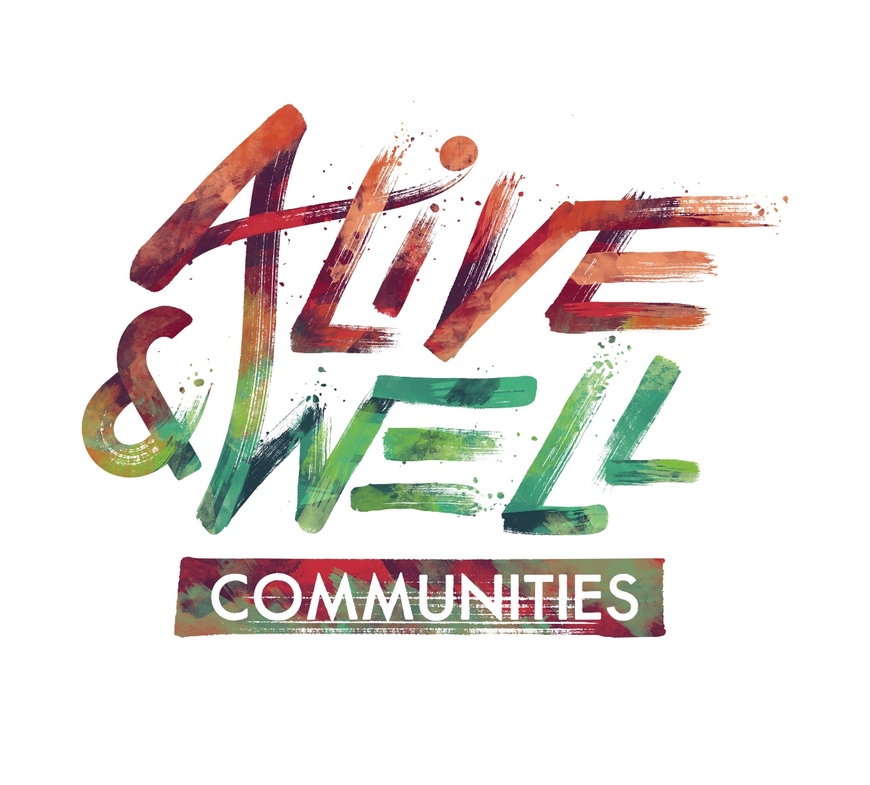
www.awcommunities.org
Notes:
We have to understand the part we play as individuals as citizens and professions in a system we inherited – how do we use our power to create change and build Alive and Well Communities, rather than perpetuate current systems that hurt others.
REMIND ALL PARTICIPANTS TO COMPLETE AN EVALUATION.

