Slide 1
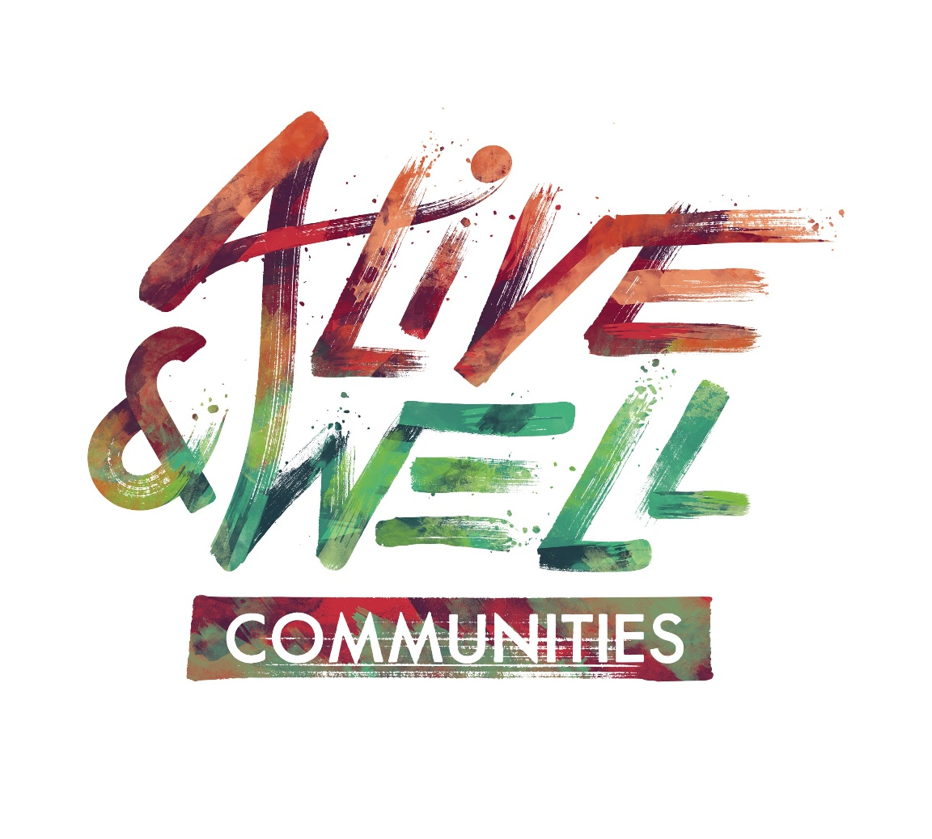
Trauma Awareness Training
Notes:
Welcome everyone and thank them for their interest in trauma. You can share with them that this training is provided Alive and Well Communities.
Remind everyone that the training will be discussing trauma and it is important for them to monitor their own reactions to the content and step- out/check-out as needed.

Slide 2

Shifting our Lens…
What stories do we tell ourselves to explain behavior?
Notes:
Today, we will discuss the science of trauma. We invite you in this conversation to consider how this information causes you to shift your lens to using what we call…the trauma lens.
You don’t have to say it out loud, but think for a minute…think of a friend or family members whose behavior you have tried to understand, but despite trying to understand you still wonder – what’s wrong with them? They may not take good care of themselves. They may rely too much on substances to make it through the day. They may not be able to hold down a job. They may get angry easily. This behavior may have come with some pretty harsh consequences, but they still persist in this behavior.
What you learn today may help explain some of these behaviors. After today’s presentation, we hope you have the tools to begin to shift the question from “What’s wrong with them?” to “What happened to them?” Ultimately, by shifting the question we believe we can identify new solutions that will make our communities healthier and more equitable.
Essential to introduce the question: “What’s wrong with you?” to “What happened to you?”

Slide 3
Trauma?
Notes:
Ask participants what they think of when they hear the word trauma. What does it remind them of or what do they think it means?
Respond by affirming their answers and then letting them know that this presentation is going to take a broad approach to understanding trauma and its impact.

Slide 4
Understanding Trauma
Event – Actual experience or threat of physical or psychological harm OR the lack/withholding/control of material or relational resources crucial to health and development. Can be a single event or repeated events.
Experience – How someone assigns meaning to the event, which depends on the perception of the individual.
Effects – Results of the person’s experience of the event. This can include neurological, physical, emotional, and cognitive effects.
  +Working definition – SAMHSA, Trauma and Justice
Notes:
As awareness of the impact of trauma grows, it is important to understand that each individual’s perception of what is traumatic may differ depending on their personal level of resiliency and the external support networks they have. Trauma is an individualized experience.
At the national and state levels, dialogues have begun to provide a more personal or individualized definition of trauma that takes into account differences in internal and external supports and strengths.
The “experience” of the “event” may be different resulting in different “effects. The first person may have few and short-term effects, while the other without intervention, supports or protective factors may have more serious effects. Remember ONLY THE PERSON WHO EXPERIENCED THE EVENT CAN SAY WHETHER IT WAS TRAUMATIC AND WHAT WAS TRAUMATIC.
You may wish to give an example of two individuals who experienced the same event but because one has a calm temperament with family and friend supports and the other has a limited social connectedness with limited friends and families to support them.

Slide 5

Private Event Trauma
Characterized by:
  Secrecy
  Power imbalance
  Sense of hopelessness
  Sense of isolation
  Sense of irretrievable loss
Notes:
Private events include any type of abuse: domestic (or IPV), sexual, verbal, emotional, spiritual, financial, technological. These events typically are conducted in secret, with the perpetrator possibly threatening to harm the victim/survivor or others in some way if they say anything. Such threats can include harm to the victim, being removed from the home or harm to a family member, manipulation, coercion, or force. In the case of young children, they may not be aware that what is happening to them isn’t “normal”.
In these situations, there is often a power imbalance between the victim/survivor and the perpetrator. This can be due to age (child and adult), financial dependence or role (teacher, priest, police officer etc). This is important as we will learn that individuals with trauma histories often do not trust people in authority, as they have been harmed previously by such people. Each of us, in our professional capacities, may be viewed as an authority figure. This impacts our engagement efforts.
Those having experienced private events often talk of experiencing a raging sense of hopelessness. Perhaps because of the secrecy and power imbalance, they believe there is no hope that anything will change.
A sense of isolation is reported as well, cut off from others since they can’t talk about it. They may also feel different from others or isolate themselves so no one will discover the truth.
People report having a sense of loss…it may be of their childhood, their innocence or of their safety. Each individual’s sense of loss can be different and it may not be the most horrific thing that happened. For example it could be the loss of their children to the system, or their inability to complete their education. Only the person who experienced the trauma can say what they feel they have lost.

Slide 6

Public Event Trauma
Characterized by:
  Shared experience
  Lack of judgment
  Sense of helplessness
  Forces beyond control
  Sense of irretrievable loss
Notes:
Public events that can be traumatic include natural disasters, such as a tornado or flooding, car accidents, painful and prolonged medical treatment, war or crime victimization.
These events typically are shared experiences and talked about with others. There is typically no judgment attached initially to being involved with the event.
Individuals experiencing a public traumatic event often report a sense of helplessness. This may come from feeling that they have no ability to avoid or prevent the event. We can’t stop a tornado. And like with those experiencing private traumatic events, a sense of irretrievable loss is also often reported.
As noted before, the same survival response kicks into action in the brain that prepares our body to fight, flight or freeze.

Slide 7

Community Trauma
Characterized by:
  A combination of experiences that negatively impact a community
  An event that impacts a few people but has structural and social consequences
Notes:
When we often think of trauma, we solo focus on interpersonal trauma. As we shift our thinking, we have to begin to include community trauma, recognizing it has the same potential impact of interpersonal trauma.

Slide 8
Stress-Response System
When we are faced with stressful situations, our mind and body automatically respond in one of three ways:
Fight
Flight
Freeze
Notes:
The fight, flight, and freeze response is activated whenever we are faced with any stressful situation. It triggers the release of certain chemicals and hormones in the body and can effect things like heart rate, blood flow, memory formation, and blood sugar.
This response is controlled by the most basic and primitive part of the brain and decides how to act to best support survival.
You may wish to give an example of what different reactions look like in the face of a threat, i.e. when we encounter a bear (do we fight it, run away, or play dead?) or in a situation like domestic violence.
Focus on the automatic nature of this reaction.

Slide 9
Chronic Trauma
Multiple instances of the same traumatic event
Multiple traumatic events happening to the same person
Environmental or community trauma
or
or
Chronic Trauma, regardless of the type, has a cumulative effect-impacting the brain, body, and all areas of functioning.
Notes:
Chronic trauma refers to multiple traumatic events happening to the same person. It can be the same type of event occurring over a period of time (physical abuse, sexual abuse, domestic violence etc.) or it can be different types of events that occur to the same person over a period of time. For example, a child who was physically abused as an infant; had an intrusive, painful medical procedure at the age of 5; was in a car accident in which a sibling was killed at the age of 8; and was raped in the community at the age of 10.
The impact of these events is cumulative and should not be viewed as separate discrete events. Each subsequent event brings forward memories and reactions from the previous event.
Chronic trauma is also connected to toxic stress, or the kind of stress that negatively impacts the body because of continuous activation of the stress response. Examples include things like living in poverty, chronic hunger, living in violent neighborhoods, etc.
Chronic trauma is typically when we see the most devastating impact on an individual’s functioning in all areas and what we typically will be referring to throughout this presentation.

Slide 10

Prevalence of Trauma
More than 50% of the general population have experienced at least one traumatic event.
What is the prevalence of trauma in your community?
Notes:
The 50% prevalence rate came from the Adverse Childhood Experiences Study. More recent surveys have seen the prevalence for 1 or more traumatic events go as high as two-thirds of the adult population. Twenty-five percent of the adult general population has experienced two or more traumas; one of 16 adults has four or more traumatic events and one out of 22 has 6 or more events. This is considered CHRONIC trauma.
Many systems such as child welfare, domestic violence and mental health have extremely high rates, between 80-100%.
Ask participants what they think the prevalence rate is in the community they serve, work in, or live in. Often, they will indicate a much higher prevalence. Affirm that as we broaden our definition of trauma and toxic stress, we see even higher rates than mentioned on the slide.

Slide 11
Prevalence of Trauma
As adults, children who were placed in foster care have PTSD rates TWICE as high as US War Veterans. (Northwest Foster Care Alumni Study, Pecora, et al., 2005)
Nearly 40% of adolescents have directly witnessed an act of violence. (Flannery, D., and Huff, C.R. Youth violence: Prevention, intervention, and social policy. Washington, DC: American Psychiatric Press, 1998)
Despite the importance of epidemiologic information, obtaining precise estimates of the prevalence and incidence of different types of potentially traumatic events that can occur in childhood is actually problematic. (Saunders, B. E., & Adams, Z. W. (2014). Epidemiology of Traumatic Experiences in Childhood. Child and Adolescent Psychiatric Clinics of North America, 23(2), 167–184.)
Notes:
PTSD was a diagnosis that was developed in response to the needs of veterans from the Vietnam War, yet adults who were in foster care have a higher rate of this diagnosis.
What does this tell us about some systems? We know that to go in state custody children theoretically have been exposed to abuse and/or neglect, but like many systems designed to help, it may actually unintentionally do further harm. In this case, that harm may come from moving a child from place to place, disrupting relationships and perpetuating not feeling safe and being disempowered.
This difficulty in getting true prevalence rates due to several factors, including the inherent nature of some of the types of traumatic events that children experience, the assets available to the field for detecting and counting events, and confounding methodological issues between studies.

Slide 12
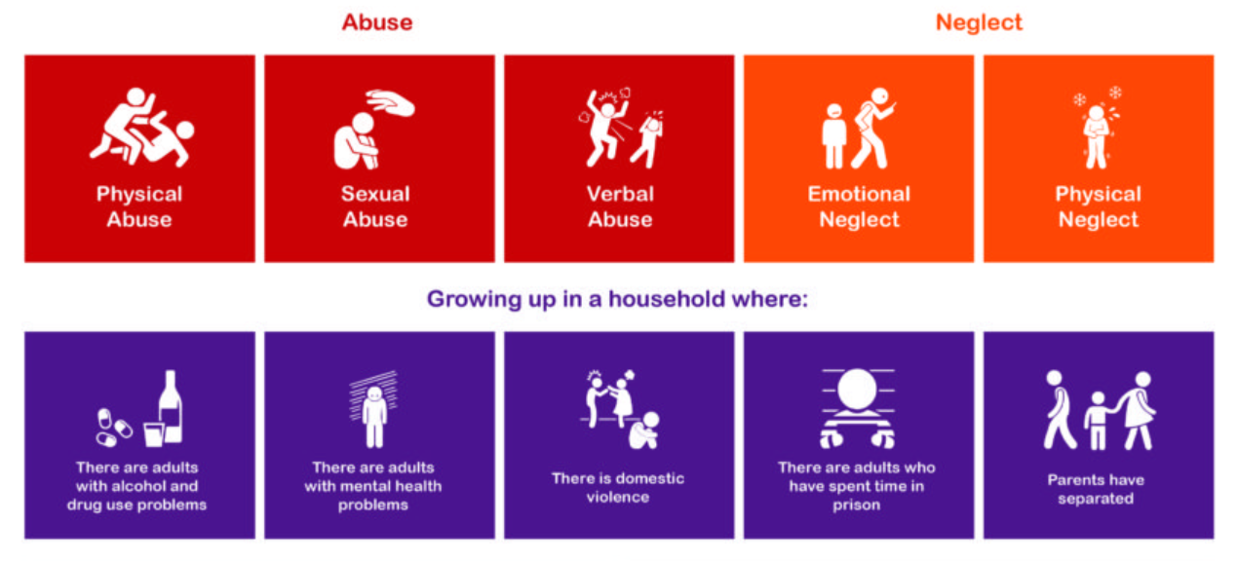
Adverse Childhood Experiences (ACEs)
Source: Liverpool CAMHS
Notes:
The Adverse Childhood Experience (ACE) Study is the seminal research that identified the impact that childhood trauma could have on long-term functioning and outcomes.
Conducted in 1995 by Kaiser Permanente and the CDC with over 17,000 participants in which their medical and social histories were examined. It was here that the relationship between childhood abuse and negative household functioning was found to be related to long-term health and social outcomes.
The slide shows the 10 types of childhood adversities examined in the study.
Take an opportunity to discuss the demographics of individuals involved in this study. This is an opportunity to note who was include and who was not included.
Highlight that the ACE study only looked at 10 types of adversity(trauma). If time permits, explore other types of adversities (traumas) that children today experience. Examples: loss of a loved one, medical trauma, poverty, etc.
In the Philadelphia ACE Study (often referred to as The Urban ACE Study) conducted in 2012/2013, 9 original ACE indicators: Experiencing physical, sexual or emotional abuse; experiencing physical or emotional neglect; witnessing domestic violence in the home; living with someone who abused substances, was mentally ill, or who was imprisoned/sentenced to serve time and 5 newly identified Urban ACE indicators: Experiencing racism, witnessing violence, living in an unsafe neighborhood, living in foster care, or experiencing bullying were examined.
Refer to the resource sheet in your training binder for additional information on the study demographics and findings of the study.

Slide 13
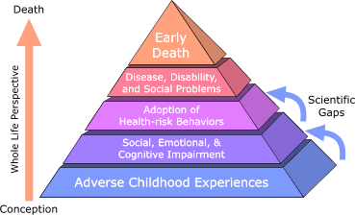
Impact of Trauma
First published in 1998, the Adverse Childhood Experience Study showed that:
Traumatic experiences are vastly more common than recognized or acknowledged
There is a powerful relationship between emotional experiences as children and physical and mental health as adults, including diabetes, heart disease and some types of cancer, as well as depression, alcoholism and drug abuse
Notes:
Review these major findings. Research is ongoing with this original cohort of individuals tracking their long term outcomes. States are beginning to gather their own data through surveillance studies.
About the pyramid:
The ACE Pyramid represents the conceptual framework for the study. During the time period of the 1980s and early 1990s information about risk factors for disease had been widely researched and merged into public education and prevention programs. However, it was also clear that risk factors, such as smoking, alcohol abuse, and sexual behaviors for many common diseases were not randomly distributed in the population. In fact, it was known that risk factors for many chronic diseases tended to cluster, that is, persons who had one risk factor tended to have one or more other risk factors too.
Because of this knowledge, the ACE Study was designed to assess what we considered to be “scientific gaps” about the origins of risk factors. These gaps are depicted as the two arrows linking Adverse Childhood Experiences to risk factors that lead to the health and social consequences higher up the pyramid. Specifically, the study was designed to provide data that would help answer the question: “If risk factors for disease, disability, and early mortality are not randomly distributed, what influences precede the adoption or development of them?” By providing information to answer this question, we hoped to provide scientific information that would be useful for developing new and more effective prevention programs.
The ACE Study takes a whole life perspective, as indicated on the orange arrow leading from conception to death. By working within this framework, the ACE Study began to progressively uncover how adverse childhood experiences (ACE) are strongly related to development and prevalence of risk factors for disease and health and social well-being throughout the lifespan.
- CDC Website

Slide 14
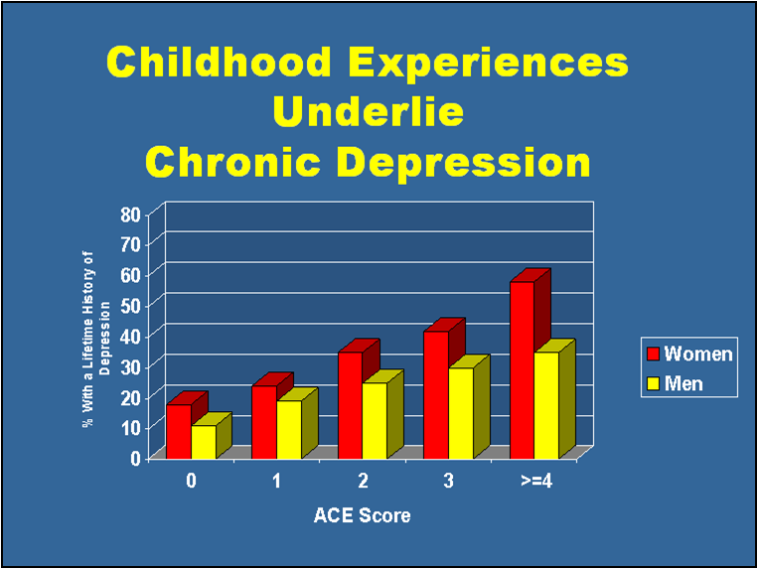
Impact of Trauma
Notes:
Here is one example that shows the relationship between exposure to adverse childhood experiences and likelihood of having chronic depression. For women with no such experiences, less than 20% ever received a diagnosis of depression. While of those with more than four such experiences almost 60% received such a diagnosis.
Notice that women have a higher rate of depression across the board than men. This may be due to two reasons. One is that women internalize more than men so may be at higher risk for developing depression in response to adverse experiences. However it may also be a “self-report” issue as men are less likely to express feelings and/or receive treatment/support for depression.
ACE Study found that adults with an ACE score of 4 or more were 460% more likely to be suffering from depression.

Slide 15
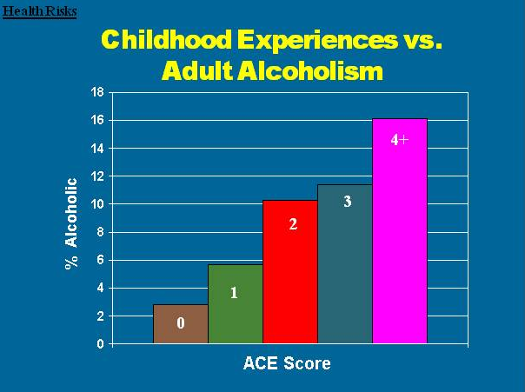

Impact of Trauma
&
Notes:
This graph demonstrates the relationship between adverse childhood experiences and rates of alcohol use disorders in adults.
Explain that alcohol, just like other substances, can be used as a coping mechanism. Used over time, this can lead to substance use disorders and negative impacts on one’s life and functioning.
Here we see that more than a 500% increase in adult alcohol use disorders is related in a strong, graded manner to adverse childhood experiences.
Beyond alcohol:
When we studied the relation of injecting illicit drugs to adverse childhood experiences, we again found a similar dose-response pattern; the likelihood of injection of street drugs increases strongly and in a graded fashion as the ACE Score increases.
At the extremes of ACE Score, the figures for injected drug use are even more powerful. For instance, a male child with an ACE Score of 6, when compared to a male child with an ACE Score of 0, has a 46-fold (4,600%) increase in the likelihood of becoming an injection drug user sometime later in life

Slide 16
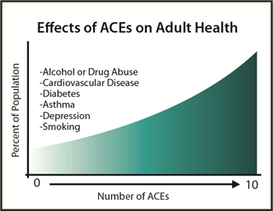
Impact of Trauma
Notes:
This graph demonstrates the relationship between adverse childhood experiences and various health outcomes: the more adverse childhood experiences reported, the more likely a person was to develop heart disease, cancer, stroke, diabetes, skeletal fractures, and liver disease as an adult.

Slide 17
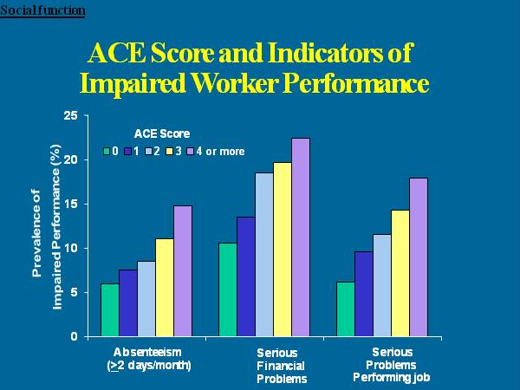
Impact of Trauma
Notes:
Here is another example, but this shows how adverse childhood experiences can impact our employment capacities. As the number of adverse experiences goes up, so does the risk of having higher rates of absenteeism, serious financial problems or serious job problems (frequent disciplinary actions, difficulty maintaining a job etc.)
Keep in mind – this data is from employed and insured people. They have work. But they are experiencing considerable difficulty within the work environment and issues with authority (sometimes caused by private event trauma) can lead to difficult relationships with bosses/supervisors.
Domestic violence victims lose nearly 8 million days of paid work per year in the US alone—the equivalent of 32,000 full-time jobs. The costs of intimate partner violence in the US alone exceed $5.8 billion per year: $4.1 billion are for direct medical and health care services, while productivity losses account for nearly $1.8 billion.
The ACE study shows a higher prevalence of chronic disease for people with higher ACE scores-people with more health problems are more likely to miss work because they are sick.
Missing work or having difficulties with a boss is going to make it difficult to get promotions, maintain employment, etc., leading to financial problems.

Slide 18
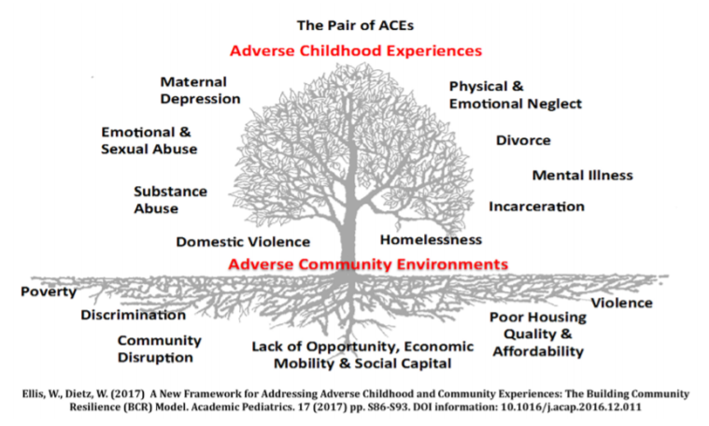
Notes:
The leaves on the tree represent the ‘symptoms’ of ACEs that are easily recognized in clinical, educational and social service settings, such as a well child visit or a pre-school classroom. Adverse childhood experiences can increase a person’s risk for chronic stress and adverse coping mechanisms, and result in lifelong chronic illness such as depression, heart disease, obesity and substance abuse. Physical or sexual violence, and abuse or neglect are often less obvious but can exist as chronic stressors.
The tree is planted in poor soil that is steeped in systemic inequities, robbing it of nutrients necessary to support a thriving community. Adverse community environments such as a lack of affordable and safe housing, community violence, systemic discrimination, and limited access to social and economic mobility compound one another, creating a negative cycle of ever worsening soil that results in withering leaves on the tree.

Slide 19
Layers of Trauma
Poverty
Racism
Individual
Trauma
Community
Trauma
Gender Inequity
Lack of Access
Historical
Trauma
Systemic
Oppression
Xeno-phobia
Violence
Notes:
There is limited recognition of the various types of trauma that may impact an individual. Often, only interpersonal trauma is recognized as having an impact. While interpersonal trauma is often viewed as more correlated and tangible, lying underneath are all of the Adverse Community Environments – the community trauma. Community trauma has roots is historical mechanisms: racism, historical oppression of certain ethnic groups/religious groups, and transgenerational poverty. Note: While there is a national narrative of historical trauma, each individual community has its own unique presence of historical trauma that layers on top of the national narrative. Historical trauma is the result of systemic oppression, and systemic oppression continues to fuel historical trauma today.

Slide 20
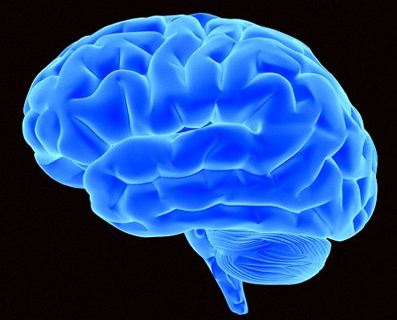
Brain Development
At birth, the brain is about 25% the size of the adult brain in weight and volume (less than 1lb), but contains nearly the same number of brain cells or neurons (86 billion).
The brain stem and lower brain are well developed, but the higher regions are less developed.
Notes:
So how does this happen…how do these childhood experiences result in these types of negative outcomes? Research now shows us how these childhood traumas impact our brain functioning. To understand we first need to understand a little about how the brain develops.
You may wish to tell participants that it is not crucial to understand all the science behind brain development and the impact of trauma, but it is important to understand that these responses are “wired” into the brain, so we cannot expect an individual to just stop the negative response.
At birth the brain is about 25% of the adult brain in weight and volume. However, the newborn brain has about the same number of neurons or brain cells as that of an adult. Brain development is not about growing brain cells but about growing connections between brain cells. The brain is wired to learn.

Slide 21
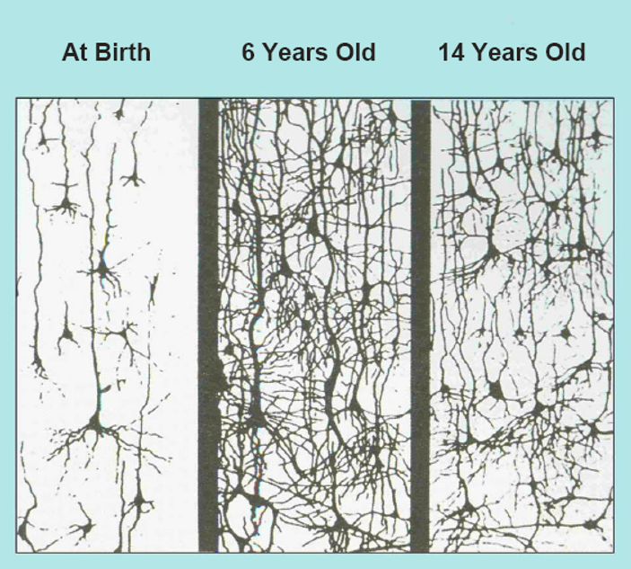
Synaptic Density
Notes:
Growing connections happens through stimulation or experience. The first five years are the most critical period for brain development. During this time we want to provide the infant with positive stimulation and an accessible, attuned and responsive adult. Cells/neurons. With repeated exposure, those connections get stronger and stronger. In the field of neurodevelopment it is said that “neurons that fire together, wire together”. We provide experiences such as exposure to language, rattles and other toys to develop eye-hand coordination. With each new experience, new connections are made between the involved brain cells/neurons. With repeated exposure those connections get stronger and stronger.
Adolescence is the 2nd most critical period of development. In adolescence the brain begins to prune neural connections that are weaker because they are not used frequently. This is a natural, healthy process, just like the idea to keep a tree healthy, we prune some of the branches. This pruning process makes the existing neural connections stronger.
Participants often ask whether these unused synapses can return. The answer is basically yes, particularly those in the higher portions of the brain. As we grow older this may take more targeted, intensive and longer interventions, but the brain has plasticity which allows for this continued growth and recovery. It is never too late to have an impact.
This slide shows the growth and pruning process for neural connections/synapse. At birth, you can see the dark dots are the nerve cells with the long single strand being an axon which carries the information from the nerve cell to the next nerve cell where it is picked up by one of the dendrites from another nerve cell. At age 6, the picture in the middle shows the increasing number of synaptic connections; it is very dense. The picture on the right shows the reduction at the age of 14.

Slide 22

Impact of Trauma on the Brain
Trauma can impact the developing brain by…
Reducing the number of connections formed
Reducing the size of the cortex
Strengthening survival connections
Resulting in…
Memory problems
Attention difficulty
Language development delays
Emotional and behavioral regulation issues
Notes:
So as we noted, experiences and stimulation lead to increasing development of neural connections. It doesn’t matter whether the stimulation is from positive or negative events-the same process occurs.
Repeated experiences lead to stronger and faster connections, which results in more automatic responses. Think of how we practice skills we want to improve, whether swinging a baseball bat or playing a musical instrument. We practice, practice, practice to get better and it becomes almost an automatic response. We don’t have to stop and think about what to do, it just happens.
So think about if a young child is exposed to repeated trauma. That child’s response to the traumatic events becomes “wired into the brain” and with repeated exposure becomes a strong, immediate response. Think back to the survival brain and the three responses programmed into our brain… fight, flight or freeze. When an individual is feeling unsafe or there is a trigger or reminder of past trauma, this part of the brain takes over from the more rational part of the brain.
Some of the impact this can have on a young child’s brain affects the child’s memory, attentional, perceptual, cognitive, and language abilities, as well as the ability to regulate one’s emotions.

Slide 23


Impact of Trauma on the Brain
When the stress response is activated, the release of cortisol can lead to the creation of flashbulb memories of events associated with intense emotional reactions, both positive and negative.
Triggers are formed that allow for intense physiological recall of these powerful memories.
Notes:
It’s important to emphasize that cortisol does not only impact memories of negative traumatic events, but can also create vivid memories of extremely positive moments in life.
Important to distinguish these types of memories from other types of memory-memories formed during times the stress response system is activated often evoke feelings throughout the entire body.
These memories can be associated with “triggers.” Triggers cause people to recall previous traumatic experiences and create physical reactions and interruptions in emotional and behavioral regulation.

Slide 24




Impact on the Body
If an individual’s body is responding to acute stress for a prolonged period, whether a child or adult, the increased adrenaline and other hormones can cause increased blood sugars, heart rates and changes in blood flow along with other often harmful biological responses.
Notes:
As part of our body’s response to stress, trauma and perception of danger, chemicals are released. We are all familiar with the impact adrenaline has. A little can help us get through a situation…speaking in public, running a race etc. But too much for too long does not feel good and can literally wear out our body.
Another chemical, glucocorticoids, are released when there is a sudden emotional response…good or bad..that creates what is called flashbulb memories. These are vivid snapshots of the event. This may play a role in the development of flashbacks and/or triggers.
When our body is under constant threat with little recovery time, our stress response reactions do not return to normal, and may get “stuck”.
Some other effects of increased adrenaline and other endocrine hormones in combination include:
Increased cortisol production. Cortisol is a steroid that counters pain and inflammation and keeps blood-sugar at a certain level.
Increased blood sugar. This blood sugar is used to feed the brain and muscles.
Increased heart rate. Blood is pumped more quickly around the body.
Changes in blood-flow. Arterial blood pressure increases. Blood is diverted away from hands, feet and stomach, and towards your brain and major muscle groups. This helps the brain assess the threat and prepares the muscles for action.
Increased platelet levels. More platelets in the bloodstream helps blood clot better and faster if physically injured.
Increased endorphin levels. Endorphins help to dull pain which may allow the body to ignore the pain long enough to engage in survival behaviors.

Slide 25
Activating
Event
Hyper-arousal
“Acting Out”
Normal Range
Window of Tolerance
Hypo-arousal
“Shutting Down”
Notes:
After a traumatic event, or cumulative traumatic events over time, or when memories or dynamics of past trauma are triggered again and again - too much activation can overwhelm this reciprocal system of the Autonomic Nervous System. The system can get tragically stuck and homeostasis and the natural internal rhythm may be lost. The person can get stuck on high in Sympathetic hyperarousal that can result in chronic symptoms of anxiety, panic, rage, and/or hyperactivity. Conversely, the person’s nervous system can get stuck on low and fall into the depths of Parasympathetic depressions, disconnection, exhaustion and numbness. Both systems can get stuck at the same time as with one foot on the accelerator of a car and the other on the brake. This results in what is called the freeze response and feelings of chronic helplessness, fatigue, poor concentration and a sense of internal collapse may result. It’s that deer in the headlight look. And as the body’s usual defensive strategies of fight or flight have been thwarted, the survival energy can become locked in the body, trapped in the nervous system. This model is very helpful in helping individuals understand that the symptoms they are experiencing are normal responses of their “nervous system” to abnormal events or to present day triggers to past overwhelming events. This is a natural physiological process. This often makes people feel very relieved because the symptoms can often make people feel like they are going “crazy” IN SUM: we know what the causal pathway is.
This slide shows the pattern of arousal under stress for individuals experiencing chronic trauma. With little time for recovery in between events, the individual goes up and down and then gets stuck either on hyper-arousal or hypo-arousal.
With the former, the individual stays at a higher level of arousal. Research suggests for example that individuals with chronic trauma often have higher resting heart rates than those without a trauma history. When hyper-aroused, individuals may display hyperactivity, hypervigilance (scanning the environment for risk or danger), mania, anxiety or panic and rage. You can ask what diagnoses this may look like and how treatment without recognition of trauma could affect the person’s recovery.
When stuck on hypo-arousal the person may experience depression, dissociative episodes, fatigue and/or numbness. Again you can discuss with participants how this may impact a person’s ability to comply with service plans, meet the child’s needs, manage day to day functioning.

Slide 26
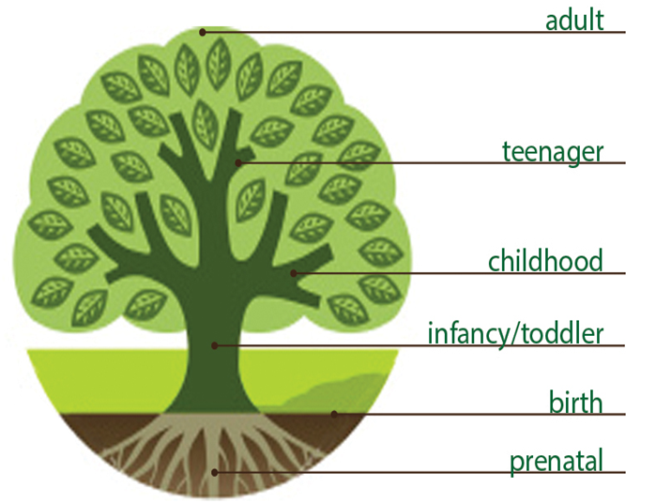
Trauma and Development
How trauma is experienced is dependent on both developmental and life stages.
Change, whether between major stages of development or within someone’s life circumstances, can often result in the
re-emergence of symptoms.
Symptomology is not bound by stages-all symptoms can be experienced throughout the lifespan.
Notes:
To understand the impact of trauma, we need to know the development stage(s) the person was in when experiencing the trauma AND their current stage of development and how the trauma history may impact them now. For example, a child who was sexually abused when a young child, may receive appropriate treatment at that time, but as they move into puberty, new triggers may require additional treatment to manage the current developmental requirements.
It’s also important to emphasize that the effects of trauma are not limited to only specific stages of development and may continue throughout development until intervened upon. For example, if a child experiences memory problems and difficulties in paying attention, they may continue to experience that into adulthood.

Slide 27
Trauma and Early Childhood
The trauma of not having a healthy relationship with a primary caregiver can result in difficulty in:
  Regulating emotions
  Trusting others
  Feeling free to explore environments
  Developing sense of self
High risk due to rapid development
Less able to anticipate danger
Cannot always express feelings in words
Notes:
An accessible, attuned and responsive caregiver continues to provide this early exposure to emotional regulation and learning how to interact with our environment. An infant cries, an accessible and attuned caregiver hears and understands the cry of the infant to know that there is an unmet need…I am hungry, I am cold, I have a wet diaper, I am tired. This caregiver then responds appropriately, meeting that infant’s needs. The infant’s brain learns (becomes wired) to understand that I can trust my caregiver to meet my needs and the world is generally a safe place. From this, the infant and growing child feels safe enough to explore the environment and learn to manage and eventually master the environment, knowing that if it becomes unsafe they can return to their responsive caregiver. If the infant’s early experiences, however, are that their caregiver is not accessible, attuned and responsive, then the world does not seem like such a safe place and the child may be unwilling to explore the environment. They do not have the “safe” caregiver who can meet their needs. This too gets wired into the brain and the child does not learn that there is a connection between their behavior and consequences or an effect on the environment. Relationships are not seen as responsive and safe.
A responsive caregiver also teaches early self-regulating skills by holding the infant/child close to their chest to hear the rhythmic soothing of the heartbeat and rocks the child which also naturally helps regulate our body’s response. WE can use these tools later for an unregulated child by using rhythmic, repeated sensory experiences to help build this in the brain.
The attachment between a child and caregiver is the primary source of safety and stability in a child's life. This earliest of relationships sets the framework for the child’s development in many areas including those listed here on the slide.
As discussed before, an accessible, attuned and responsive caregiver teaches the infant that the world is relatively safe and will meet our needs, that people can be trusted to support us, that we are capable of exploring and having an impact on the world etc. Our early lessons in soothing come from being held and rocked as well as watching our caregivers manage their own emotions.
Complex trauma exposure can interfere with the formation of a secure attachment bond between a child and her caregiver. Lack of a secure attachment can result in a loss of core capacities for self-regulation and interpersonal relatedness. Children exposed to complex trauma often experience lifelong problems that place them at risk for additional trauma exposure and other difficulties, including psychiatric and addictive disorders, chronic medical illness, and legal, vocational, and family problems. Toddlers or preschool-aged children with complex trauma histories are at risk for failing to develop brain capacities necessary for regulating emotions in response to stress. Trauma interferes with the integration of left and right hemisphere brain functioning, such that a child cannot access rational thought in the face of overwhelming emotion. Abused and neglected children are then prone to react with extreme helplessness, confusion, withdrawal, or rage when stressed.

Slide 28
Trauma and Early Childhood
Children often do not understand cause and effect, which can result in blaming themselves or caregivers
Children have a profound lack of control over their environments
Children are often going through trauma alongside their primary caregiver
Parent/child shared trauma impacts ability to parent
May blame parents/caregivers for not preventing stress and trauma
Notes:
A study by Davidson and Smith reported results finding that traumatic events experienced prior to age twelve are three times more likely to result in Posttraumatic Stress Disorder than such events experienced after age twelve.
Young children are most vulnerable to the impact of trauma due to the rapidly growing brain. But young children have not had time to develop cognitive capacities that can help manage the impact. All young children tend to be more sensory driven so the impact of trauma is seen much more in that area…lights, sounds, smells etc.
Again because of their limited cognitive development, young children may not be able to understand cause/effect relationships. They may not understand that their mother could not prevent the tornado or losing all their toys. How and where they place responsibility may not be based in reality.
When a parent and child share exposure to a potentially traumatic event, the parent’s capacity to manage their response impacts the child’s response. If the parent becomes emotionally dysregulated this will impact how the child processes and perceives the event.
Because young children have little real control over their environments, they have less ability to manage or respond to potentially traumatic events. A three-year-old has little ability to be able to avoid being abused by a caregiver or to even avoid exposure to witnessing domestic violence.

Slide 29
Impact of Trauma on Young Children
Trauma can result in:
Delayed development of verbal skills
Memory problems
Regressive behaviors
Aggression
Excessive crying or screaming
Problems with focus/learning
Poor appetite, low weight, digestive problems
Irritability, sadness, and anxiety
Nightmares/sleep difficulties
Compulsion to re-enact or imitate traumatic event
Exaggerated startle response
Difficulty trusting others
Lack of self confidence
Somatic complaints
Bed wetting
Notes:
As noted, the first five years are the most critical period for brain development. The brain is very influenced by experience, good or bad at this age.
The other major issue is that young children may not have fully developed language to capture their response to the event. This may make it difficult to frame the trauma event or discuss with others then or later. We should not ever think though that just because they don’t have the language to talk about the impact, that it has not impacted them.
Much of the impact for young children may be in not achieving developmental milestones such as in language. Or it might be possible that they regress in their development. For example, a child who is toilet trained may regress to wetting or soiling. This slide lists a number of other areas that may be impacted in young children.
You can use this slide to give an example of how these effects may play out in a classroom, for example a teacher who places a hand on the shoulder of a student to get their attention and the student has a physical reaction and hits the teacher. If only punishment is given without learning about underlying trauma, you will not be able to ultimately help the child learn
This slide shows a number of other examples of the impact trauma may have on young children. Naptime or bedtime may be a particular time when a child struggles with emotional or behavioral control. This may be related to timing of past traumatic events and the experience of giving up control when others are around when falling asleep.
Young children often act out some components of the traumatic event in their play or in interactions with others. This may reflect feelings of being unsafe or abusive interactions. It is important to remember not to take any actions towards you personally, but to know that this is just their way of expressing what is going on in their world.
Young children into school age often report somatic complaints such as having stomachaches or headaches when there is no physical cause identified.

Slide 30
Impact of Trauma on Adolescents
Trauma can result in:
Anxiety, fear, and worry about safety of self and others
Sudden changes in behavior
Difficulty trusting others
Repetitive thoughts and comments about death or dying (including suicidal thoughts, writing, art, or notebook covers about violent or morbid topics, internet searches)
Heightened difficulty with authority, redirection, or criticism
Re-experiencing the trauma through nightmares or disturbing memories
Sleep difficulties
Exaggerated startle response
Avoidance behaviors
Emotional numbing
Notes:
This slide lists the impact trauma may have for adolescents. Obviously any change in behavior or in relationships can be a sign of some emotional concerns. We may also see stories or pictures that are violent or morbid in nature. This may cause concern in the adults, but it should again be examined through the lens of trauma in that they may be representing what is happening in their life and may not represent a plan to harm others.
We need to remember that adolescence is the 2nd most critical period of brain development and that the adolescent “Brain” has some unique characteristics even within “typical” development. Such things as requiring a higher level of stimulation to feel normal, or interpreting anger or negative emotions to others facial expressions than children or adults.
This slide lists some additional impacts of trauma. Emotional numbing can lead to engaging in self-injurious behaviors as a way to “feel”.

Slide 31
Impact of Trauma on Adults
Depression
Lack of trust, particularly of authority
Impaired social/sexual relationships
Hypervigilance
Inertia
Substance use disorders/self-medicating
Mental illness
Emotional dysregulation
Adults may experience the impact of compounded, unaddressed childhood trauma, but also experience new traumatic experiences throughout the life span. Resulting symptoms include:
Notes:
When working with children/adolescents we also need to think about their parents or caregivers. The way an adolescent adapts to stressors has a lot to do with how well his or her family is functioning (Stern & Zevon, 1990). It has been found that when adolescents lack parental support, they are more likely to have behavioral problems and emotional distress (Garber & Little, 2001).
A system of care study looked at the prevalence of trauma within caregivers of children who have experienced trauma. The prevalence rate was high AND the number of traumas experienced was on average 7 events which means this is chronic trauma.
We must think about this when we are attempting to engage a parent/caregiver around the needs of the child. The parent may not have much trust of authority and be mistrustful of any support offered.
This slide provides some examples of how a trauma history may impact parents/caregivers. As professionals, in our roles with children and families, we need to change our perspective when a parent is not meeting objectives or goals from being non-compliant or resistant to being impacting by trauma, and help that parent manage their own emotional and behavioral responses through that lens of trauma.

Slide 32
Applying the Lens of Trauma
Notes:
Applying the Lens of Trauma to inequitable outcomes. So how do we apply the science of trauma and toxic stress to real life? What do we DO with this information? It is important for us to SEE trauma if we are going to address it. We must see trauma that occurs within and through relationships (interpersonal) and those that occur through and in our social systems and structures. Now we will begin to question how historical trauma, ACEs and adverse community environments work on peoples’ health, behavior, and life outcomes in ways that we don’t outwardly discuss in the common narrative.
Give an additional caution to the audience about the fact that this section maybe be triggering given that it’s speaking to the lived experience of many. We may even encounter personal resistance. In this section, we use the science of trauma to look at various social issues in a new way by applying the trauma lens. This may challenge many of the narratives that we hold at our very core – messages we receive from our friends, family, communities, and all forms of media. Welcome discussion but always bring it back to the science of trauma, including the stress-response system, hyper- and hypo-arousal, and the impact on the brain and body.

Slide 33
Applying the Lens of Trauma
Black children under the age of six are about three times more likely to live in poverty than their peers. Over the last four decades, at least one-third of Black children were living in poverty.¹
African Americans, Native Hawaiians and Latin Americans have been impacted greatly by hypertension and diabetes due to chronic stress resulting from discrimination. ⁴
Native Americans are sentenced to prison at four times the rate of white Americans.
Notes:
As we have talked about the impact of trauma on individuals across the lifespan, we can begin to think about the impact of trauma on whole populations. In our country, we face a long list of inequitable outcomes among minority populations. Listed here are just some of those.
What happens, when we begin to apply the lens of trauma -- to move from blaming populations but instead to ask -- what happened? We can move from explaining these outcomes as a condition of race or identity, but instead identify the structures and systems that disproportionately impact a particular race or minority group. What is in the soil in communities that is fostering adversity for our families?
We are going to explore three topics in more depth. We do not have time today to completely understand each of these and dissect what is living in the soil, but our hope is that this conversation gives you the tools to begin asking what happened and inspires you to begin to dig deeper into these questions and look for new solutions.
In 2012, 35 percent of Blacks lived in poverty, compared to 13 percent of whites. ²
In 1970, those rates were 33.6 percent and 10 percent, respectively. (this came from the Atlantic citing the Census and Kaiser Foundation)...may not want to include...it may lead to a discussion about how such a pattern can persist for almost 50 years)
1 – Urban Institute
2 – Kaiser Family Foundation: http://kff.org/other/state-indicator/poverty-rate-by-raceethnicity/
3 - nber.org
4 - Williams & Neighbors, 2001; Kaholokula et al, 2010; McClure et al, 2010
5- Lee, Ayers, & Kronenfeld, 2009; Peek et al, 2011
Job applicants with white names needed to send about 10 resumes to get one callback; those with Black names needed to send around 15 resumes to get one callback. ³
The Soujorner syndrome and the Superwoman Schema (SWS) concepts are used to explain the phenomenon of early onset of morbidity among Black women in response to persistent chronic stress and active coping associated with meeting day-to-day demands and having multiple caregiver roles (Lekan, 2009; Woods-Giscombe & Black, 2010; Slopen et al, 2010)
Perceived discrimination/racism has been shown to play a role in unhealthy behaviors such cigarette smoking, alcohol/substance use, improper nutrition and refusal to seek medical services.⁵
Children of color from immigrant families are nearly seven times less likely to be proficient in math by 8th grade than their U.S. born and primarily white peers.

Slide 34
Applying the Lens of Trauma
Large bodies of literature in sociology, economics, anthropology, and public health document that US blacks are more likely to experience stressful situations, such as material hardship, interpersonal discrimination, structural discrimination in housing and employment, and multiple caregiving roles than whites.¹
Notes:
Researchers have looked at a host of other possible factors for why Black infant mortality is so high—such as women’s poor eating habits, obesity, smoking, drinking, or poor prenatal care—but none of the factors examined, alone or together, were found to be significant enough to fully account for the racial gap.
Evidence now suggests that years of dealing with discrimination – experiencing microaggressions daily, lack of employment opportunities, public transportation limitations, or a justice system that disproportionately affects men of color – may lead to chronic stress, which takes a toll on the body and may prompt biological changes in a woman that can affect the health of her children.
By understanding how discrimination and racism are creating this outcome, we can begin to address these traumas in our communities.
1. Geronimus A, et al: Do US Black Women Experience Stress-Related Accelerated Biological Aging? Human Nature, 2010;21: 19-38
Large literatures in sociology, economics, anthropology, and public health document that US blacks are more likely to experience stressful situations, such as material hardship (Charles and Guryan 2008; Mayer and Jencks 1988), interpersonal discrimination (Barnes et al. 2004; Taylor and Turner 2002), structural discrimination in housing and employment (Charles and Hurst 2002; Darity and Mason 1998; Holzer et al. 2005; Ondrich et al. 2003; Yinger 1998), and multiple caregiving roles (Dilworth-Anderson et al. 2002; Hicks-Bartlett 2000; Lum 2005) than whites.¹

Slide 35
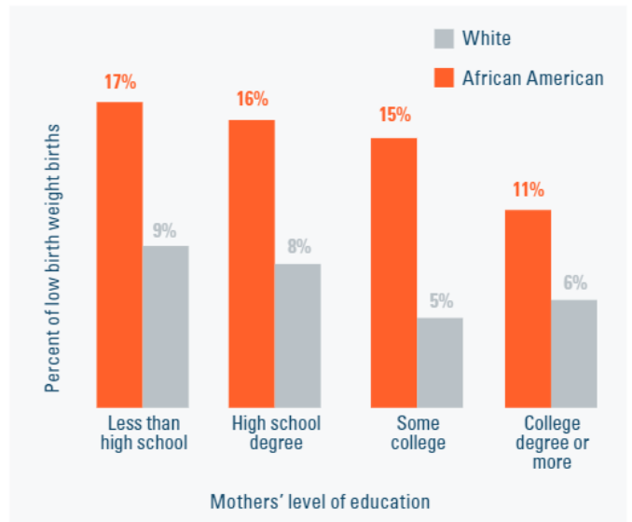
Applying the Lens of Trauma
Source: MODHSS, Birth MICA
Notes: Prenatal care adequacy (Missouri index)
Notes:
Many public health experts consider the percentage of babies born weighing fewer than 2,500 grams is a fundamental measure of community health.
Although education is important to health, it is not the only explanation for health disparities. The figures above show that at every level of education, there is still a considerable difference between Black women and white women in receipt of adequate prenatal care, resulting in low birth weight. Of particular note is that Black women with a college degree or more education are more likely to have a low birth weight baby than white women with less than high school education. Low-birth-weight and preterm infants are at an increased risk for many health and academic problems that last through adolescence
– For the Sake of All report
The reason for disparities in low birth weight is too often ascribed to race and not racism. It is not race that determines birth outcomes, but rather the lived experience of minority status in a discriminatory society and the legacy of concentrated disadvantage that result in unequal birth outcomes. Racism — not race — is a fundamental driver of unequal health outcomes. There is a tendency in previous research to falsely categorize race as the essential risk factor for low birth weight delivery. Research highlights the importance of accelerating the shift in focus among public health policy makers from blaming the victim – black women - towards a better understanding of how structural determinants of health drive inequities.
- Study: Racism to Blame for Low Birth Weights (Taken from Rush University’s Website on 7/1/18: https://www.rushu.rush.edu/news/study-racism-blame-low-birth-weights)
Full text: Fernando De Maio, Raj C. Shah, Kellie Schipper, Realino Gurdiel & David Ansell (2017): Racial/ethnic minority segregation and low birth weight: a comparative study of Chicago and Toronto community-level indicators, Critical Public Health, DOI: 10.1080/09581596.2016.1273510 To link to this article: http://dx.doi.org/10.1080/09581596.2016.1273510

Slide 36
Applying the Lens of Trauma
Suicide is the second leading cause of death for adolescents ages 10-19 in the US.¹
Youth who identify as sexual minorities have rates of suicide up to 3 times higher.²
74% sexual minority youth reported experiencing verbal harassment because of their sexual orientation, 33% reported physical harassment³, and 72% cyberbullying.⁴
Youth who identify as sexual minorities may skip school as a protective mechanism to avoid victimization. ⁵
Research indicates that increased risk of suicide for sexual minority youth is due to the various forms of school-based victimization experienced. ⁵
Notes:
After walking participants through the slide, again pose the question of “what Adverse Community Environments may underlie heightened rates of suicide for youth who identify as LGBTQ?”
Sexual minority youth (SMY) (i.e., young people who identify as lesbian, gay, bisexual, queer or unsure, or who report same-sex attractions or behaviors).
Sexual minority youth have discussed how bullying at school alters their attendance and educational trajectories. Skipping school is an important indicator of school disengagement and has been linked to an increased risk of dropping out, as well as substance use and misuse in young adulthood. Hostile school environments during adolescence, therefore, may be important for not only influencing suicidal ideation and behaviors, but also for shaping long-term socioeconomic outcomes, which may contribute to sexual orientation health disparities later in life.
The overall pattern indicated that there was no direct relationship between sexual orientation and suicide, but that SMY’s elevated risk of suicidal ideation and behaviors functioned indirectly through two forms of school-based victimization: being threatened or injured with a weapon at school and experiencing harassment specific to SO/GID appear to be especially important. Whereas SO/GID-based victimization speaks to the centrality of minority stressors on SMY’s health and wellbeing, being threatened or injured with a weapon at school highlights the grave harm that many SMY encounter in some American schools.
Faith is often expressed as a source of strength for believers, especially during times of struggle and sorrow. Studies have indicated that religion generally protects people against thoughts of suicide. But the research has also shown that religion specifically doesn’t have that impact on those who identify as lesbian, gay, bisexual or questioning. Religiosity may be linked to negative feelings among queer individuals ― including increases in suicidal behaviors when theology that doesn’t affirm queer identity. “Religious groups who stigmatize LGBT people should be aware of the potential damage they can do to an individual and families, and honestly the damage they do to themselves as an organization,” study co-author John R. Blosnich told HuffPost. Blosnich, of West Virginia University’s Injury Control Research Center. (Lytle, Megan C. et al. Association of Religiosity With Sexual Minority Suicide Ideation and Attempt. Am Jour of Preventive Medicine , Volume 54 , Issue 5 , 644 – 651.)
Heron M: Deaths: Leading causes for 2010. Natl Vital Stat Rep 2013;62:1–97.
Marshal MP, Dietz LJ, Friedman MS, et al.: Suicidality and depression disparities between sexual minority and heterosexual youth: A meta-analytic review. J Adolesc Health, 2011;49:115–123.
National School Climate Survey, 2013.
Juvonen J, Gross EF: Extending the school grounds?—Bullying experiences in cyberspace. J Sch Health 2008;78:496–505.
Bouris A, Everett BG, Heath RD, Elsaesser CE, Neilands TB. Effects of Victimization and Violence on Suicidal Ideation and Behaviors Among Sexual Minority and Heterosexual Adolescents. LGBT Health. 2016 Apr;3(2):153-61. doi: 10.1089/lgbt.2015.0037.

Slide 37
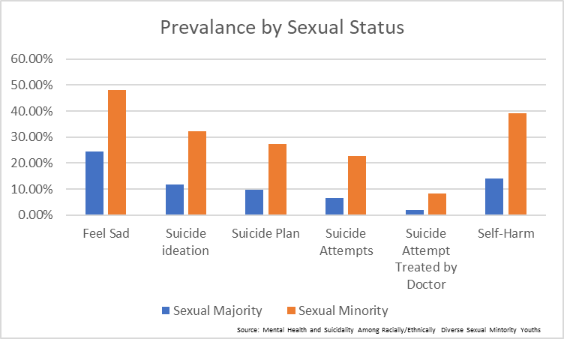
Applying the Lens of Trauma
Notes:
Sexual Majority Sexual Minority
Feel Sad 24.50% 48.10%
Suicide ideation 11.70% 32.30%
Suicide Plan 9.70% 27.40%
Suicide Attempts 6.60% 22.80%
Suicide Attempt Treated by Doctor 2.00% 8.30%
Self-Harm 14.20% 39.10%

Slide 38
Applying the Lens of Trauma
Black and low-income students receive longer suspension than their peers for the same types of infractions.
While Black students only account for 16% of enrollment, they represent more than 30% of school-based arrests.
Research suggests Black students are frequently disciplined for minor infractions such as defiance or disrespect .
Suspensions contribute to chronic absenteeism, which is associated with lower academic performance and lower graduation rates.
Notes:
Sources:
https://ocrdata.ed.gov/downloads/crdc-school-discipline-snapshot.pdf
http://kirwaninstitute.osu.edu/wp-content/uploads/2014/02/racial-disproportionality-schools-02.pdf
https://www.brookings.edu/research/2017-brown-center-report-part-iii-race-and-school-suspensions/
http://www.attendanceworks.org/absences-add-up/
http://www.justicepolicy.org/news/11809
Research shows than even when Black and white students commit the same type of infraction (i.e. fighting), Black students on average receive nearly a day longer of suspension.
The presence of law enforcement officers in schools has led to a significant increase in the criminalization of school misconduct and its impacts are not proportional to the population. Black students are more likely to have the cops called on them and are also more likely to be arrested when they are called. School based arrests are part of the larger scale discipline disparities that contribute to a prison pipeline for Black and Brown students.
Willful defiance was one of the most commonly cited reasons for suspension in California until a few years ago when the state banned it from being used. Coupled with district efforts to combat the trend, suspension rates in California have trended down significantly with this change. Note: the idea of what counts as “defiance” or “disrespect” is very connected to cultural norms. Consider who determines what is defiant behavior and what impact that has on Black and brown students. Further, think about how behaviors that are outside the window of tolerance (and resulting from trauma) may result in defiance or disrespectful behavior.
Chronic absenteeism, defined as missing more than 10% of school days for any reason (excused or unexcused) is considered the best attendance marker for connections to long term success. From the earliest grades, students who are missing more than 10% of school days for any reason (including suspension) are at risk for falling behind academically, having negative social impacts, and putting them on a track towards high school dropout.
As we shift to the graph, think about how out Black and brown students are impacted by community trauma.

Slide 39
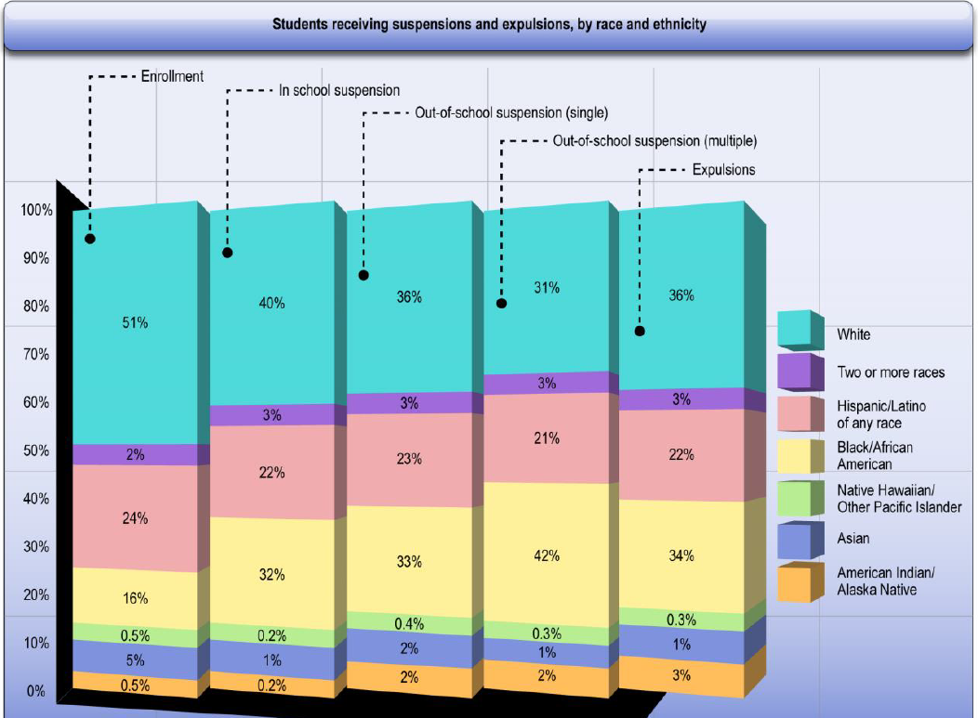
Applying the Lens of Trauma
SOURCE: U.S. Department of Education, Office for Civil Rights, Civil Rights Data Collection, 2011-12.
Notes:
After exploring the chart with participants, again pose the question of “what Adverse Community Environments may underlie heightened rates of suspensions and expulsions?”
NOTE: Detail may not sum to 100% due to rounding. Totals: Enrollment is 49 million students, in-school suspension is 3.5 million students, single out-of-school suspension is 1.9 million students, multiple out-of-school suspension is 1.55 million students, and expulsion is 130,000 students. Data reported in this figure represents 99% of responding schools.
The Civil Rights Data Collection (CRDC) reveals that students of certain racial or ethnic groups and students with disabilities are disciplined at far higher rates than their peers, beginning in preschool. The CRDC data also show that an increasing number of students are losing important instructional time due to exclusionary discipline.
Black students represent 16% of the student population, but 32-42% of students suspended or expelled. In comparison, white students also represent a similar range of between 31-40% of students suspended or expelled, but they are 51% of the student population.
Black students are suspended and expelled at a rate three times greater than white students. On average, 4.6% of white students are suspended, compared to 16.4% of black students. Through CRDC data, we can also explore suspensions by race and gender. Black boys and girls have higher suspension rates than any of their peers. Twenty percent (20%) of black boys and more than 12% of black girls receive an out-of-school suspension.

Slide 40
Becoming Trauma-Informed
A program, organization, or system that is trauma-informed:
Realizes the widespread impact of trauma and understands potential paths for recovery;
Recognizes the signs and symptoms of trauma in clients, families, staff and others involved with the system;
Responds by fully integrating knowledge about trauma into policies, procedures and practices;
And seeks to actively resist re-traumatization.
-Substance Abuse and Mental Health Services Administration
Notes:
In a trauma-informed approach, all people at all levels of the organization or system have a basic realization about trauma and understand how trauma can affect families, groups, organizations, and communities as well as individuals. People’s experience and behavior are understood in the context of coping strategies designed to survive adversity and overwhelming circumstances, whether these occurred in the past (i.e., a client dealing with prior child abuse), whether they are currently manifesting (i.e., a staff member living with domestic violence in the home), or whether they are related to the emotional distress that results in hearing about the firsthand experiences of another (i.e., secondary traumatic stress experienced by a direct care professional).There is an understanding that trauma plays a role in mental and substance use disorders and should be systematically addressed in prevention, treatment, and recovery settings. Similarly, there is a realization that trauma is not confined to the behavioral health specialty service sector, but is integral to other systems (e.g., child welfare, criminal justice, primary health care, peer–run and community organizations) and is often a barrier to effective outcomes in those systems as well.
People in the organization or system are also able to recognize the signs of trauma. These signs may be gender, age, or setting-specific and may be manifest by individuals seeking or providing services in these settings. Trauma screening and assessment assist in the recognition of trauma, as do workforce development, employee assistance, and supervision practices.
The program, organization, or system responds by applying the principles of a trauma-informed approach to all areas of functioning. The program, organization, or system integrates an understanding that the experience of traumatic events impacts all people involved, whether directly or indirectly. Staff in every part of the organization, from the person who greets clients at the door to the executives and the governance board, have changed their language, behaviors and policies to take into consideration the experiences of trauma among children and adult users of the services and among staff providing the services. This is accomplished through staff training, a budget that supports this ongoing training, and leadership that realizes the role of trauma in the lives of their staff and the people they serve. The organization has practitioners trained in evidence-based trauma practices. Policies of the organization, such as mission statements, staff handbooks and manuals promote a culture based on beliefs about resilience, recovery, and healing from trauma. For instance, the agency’s mission may include an intentional statement on the organization’s commitment to promote trauma recovery; agency policies demonstrate a commitment to incorporating perspectives of people served through the establishment of client advisory boards or inclusion of people who have received services on the agency’s board of directors; or agency training includes resources for mentoring supervisors on helping staff address secondary traumatic stress. The organization is committed to providing a physically and psychologically safe environment. Leadership ensures that staff work in an environment that promotes trust, fairness and transparency. The program’s, organization’s, or system’s response involves a universal precautions approach in which one expects the presence of trauma in lives of individuals being served, ensuring not to replicate it.
A trauma-informed approach seeks to resist re-traumatization of clients as well as staff. Organizations often inadvertently create stressful or toxic environments that interfere with the recovery of clients, the well-being of staff and the fulfillment of the organizational mission. Staff who work within a trauma-informed environment are taught to recognize how organizational practices may trigger painful memories and re-traumatize clients with trauma histories. For example, they recognize that using restraints on a person who has been sexually abused or placing a child who has been neglected and abandoned in a seclusion room may be re-traumatizing and interfere with healing and recovery.
- SAMHSA

Slide 41
The Core Principles
Trustworthiness
Empowerment
EQUITY
Choice
Safety
Collaboration
Notes:
In the Missouri Model, there are 5 core principles that guide becoming trauma informed: Safety, Trustworthiness, Choice, Collaboration, Empowerment.
The core principles fit together, like pieces of a puzzle. Only when all of the pieces are concurrently in place can a school, organization, or system become truly trauma informed. The core principles help to achieve equity, and the individual pieces fail to fit together without equity. Equity is the glue that authentically hold the pieces together in a trauma informed school, organization, system.
Briefly go through the core principles, tying them back to the science of trauma and its impact on the brain and body.
Safety – this stems from being exposed to the potential for physical harm whether through abuse, natural disasters, car accidents, etc. For example, most of us function day to day believing we are generally safe from harm and/or can predict risk for harm. However, if the harm comes from a caregiver, who is supposed to keep you safe, how you view others as safe or unsafe is impacted. We must recognize that safety goes beyond physical safety and includes emotional (psychological) and relational safety as well.
Trustworthiness – as with safety, trustworthiness impacts how individuals may perceive relationships. Whenever there is a power imbalance, the trauma survivor may feel unsafe and not be able to start with framework of trust. We must earn that trust over time by facilitating safety, being consistent and not making promises that we cannot keep despite good intentions.
Choice – Individuals who experience trauma often report feeling hopeless and helpless – choice is taken away when experiencing trauma. An individual may believe that it doesn’t matter what they do as given that the outcome is out of their control. By providing developmentally appropriate choices, we can help the individual learn mastery and that they can influence their environments and relationships.
Collaboration - In combination with the other principles we should always work WITH an individual, avoiding making decisions about the individual without their ACTIVE participation. Consider the perspective of perceived or real power imbalances within our relationships.
Empowerment – How systems and individuals support those who have experienced trauma in becoming empowered to take control over their life (again) and to help counter the feelings of hopelessness and helplessness.

Slide 42
Intervention
Many effective therapeutic interventions are available for individuals of all ages through various individual or group modalities.
Trauma is not “cured” – therapeutic intervention is unable to erase the traumatic event(s) and individuals may require additional intervention at various points throughout the lifespan.
You don’t have to be a therapist to be therapeutic. One buffering, supportive individual can mitigate the trajectory of trauma.
Notes:
Transition from macro-level to the individual level…
There is growing evidence however that individuals with chronic trauma may not have yet developed the cognitive capacities to benefit from these predominantly cognitively based interventions. In those cases, we may need to start with more sensory interventions that focus initially on lower, more primitive parts of the brain to help build cognitive capacities.
These sensory interventions are often repetitive rhythmic activities that may mimic our early learning of emotional and behavioral regulation. Remember brain growth is hierarchical so we need to build a solid base to be able to support higher level development.
Remind audience that not all individuals who experience trauma will require a clinical-level of intervention.
“Significant” is not determined by clinical standards; rather, what an individual determines to be significant: Loss of a job, move to a new city, becoming a parent, ending a relationship, etc…
2/3 of children only need the intervention of one buffering, supportive individual – the power of relationships.

Slide 43
Responding to People with Trauma
We must:
  Acknowledge that we may unintentionally trigger someone’s trauma response.
  Work to see an individual’s responses and behaviors as the result of changes in the brain and body.
  Strive to see the world through the lens of trauma.
Notes:
We learn about trauma ideally to improve our response to children and adults who have lived experience with trauma, whether it is in mental health, domestic violence, education, juvenile justice, corrections, physical health, etc.
Our first concern obviously is to “do no harm”. Unfortunately, sometimes what we do unintentionally can trigger a trauma response and increase an individual’s level of feeling unsafe causing more anxiety.
Our interventions are also often ineffective if we don’t understand the physiological impact trauma can have. The use of behavior modification is common and may lead to escalating behavior rather than assist the individual in managing their physiological response. We need to re-conceptualize individual’s responses from being intentional to being physiologically based.
Additionally, policies, practices and environments need to be reviewed through the lens of trauma to ensure we are not triggering an individual and that we have the capacity to support individuals with trauma histories.

Slide 44
Changing the Question
To become alive and well, we need to change the question from…
What’s wrong with you?
to
What happened to you?
Notes:
So as we begin our journey learning more about the impact of trauma, we must shift our perspective. We must stop thinking in terms of “what is wrong” with someone and with the goal of getting them to stop doing whatever it is that is causing problems for themselves and others. Instead we should look through the lens of trauma and ask “What happened to you” to begin exploring the events that shaped their brain and subsequently their emotions, behaviors, relationships and a multitude of other capacities.
With this we begin to make the shift to understanding that what we and others may view as negative behaviors (substance use, delinquent or criminal behaviors, cutting, etc) are actually coping mechanisms learned and wired in our brain in an attempt to cope with chronic traumatic events.
Our focus can then shift from stopping the negative behaviors to helping develop more adaptive ways to manage overwhelming feelings, thoughts and triggers. We recognize that we must help people “rewire” their brains through consistent trusting and supportive relationships and development of self-regulatory skills.

Slide 45

www.awcommunities.org
Notes:
We have to understand the part we play as individual citizens and professions in a system we inherited – how do we use our power to create change and build Alive and Well Communities, rather than perpetuate current systems that hurt others.
REMIND ALL PARTICIPANTS TO COMPLETE AN EVALUATION.

